Slide 1

Analyzing Fast Power Abort (FPA) tests
E. Ravaioli and M. Janitschke
Thanks to colleagues from LHC-OP, MP3, MPE, QPS, SIGMON,
in particular Z. Charifoulline, C. Obermair, A. Verweij
CERN, Geneva, CH
1 December 2022

Slide 2
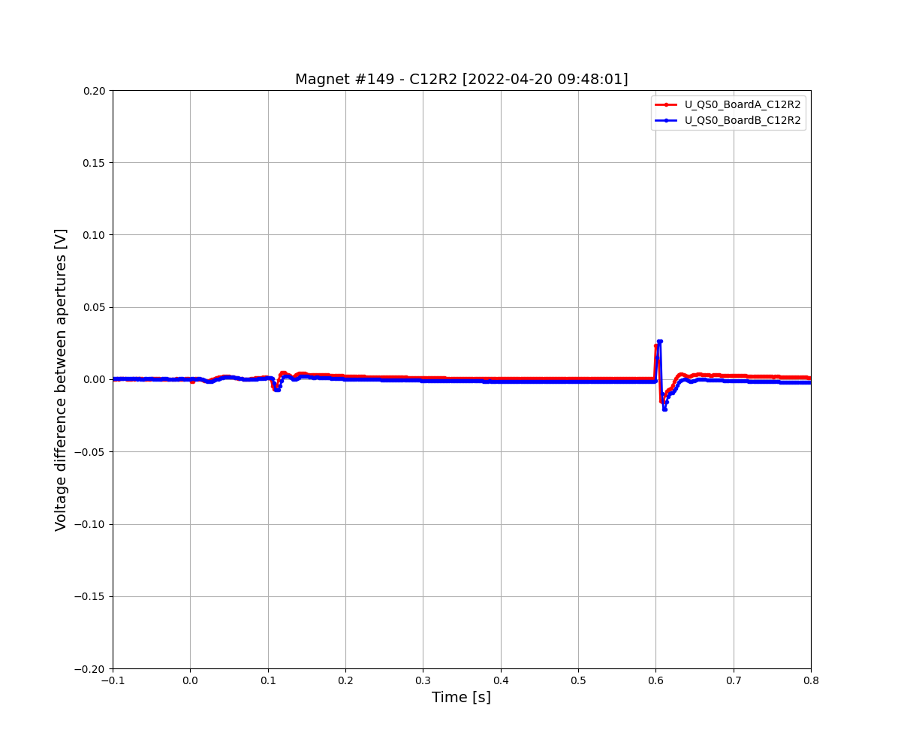
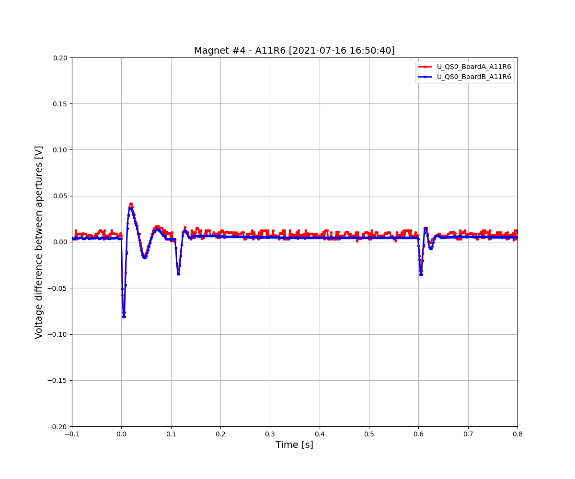
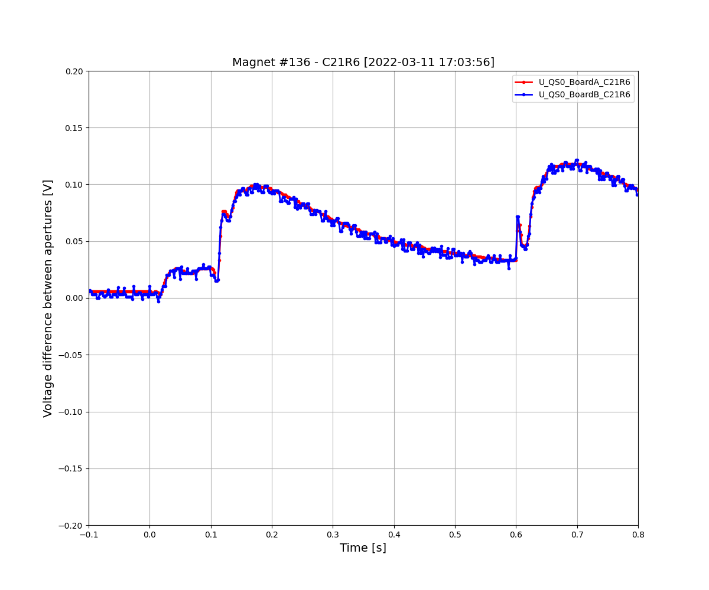
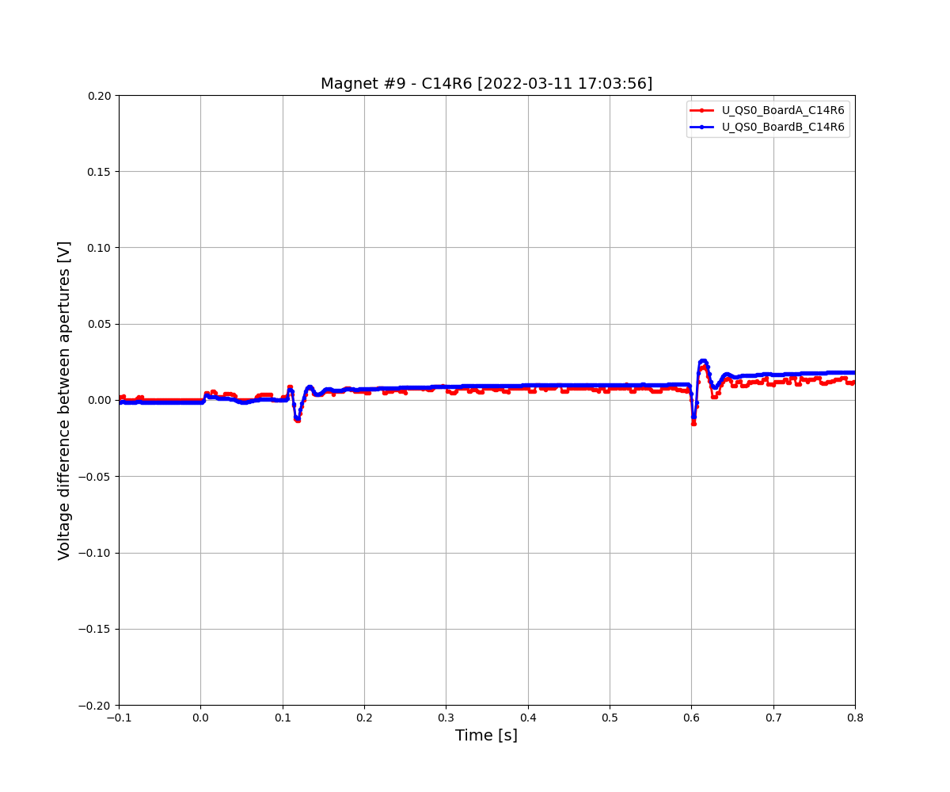
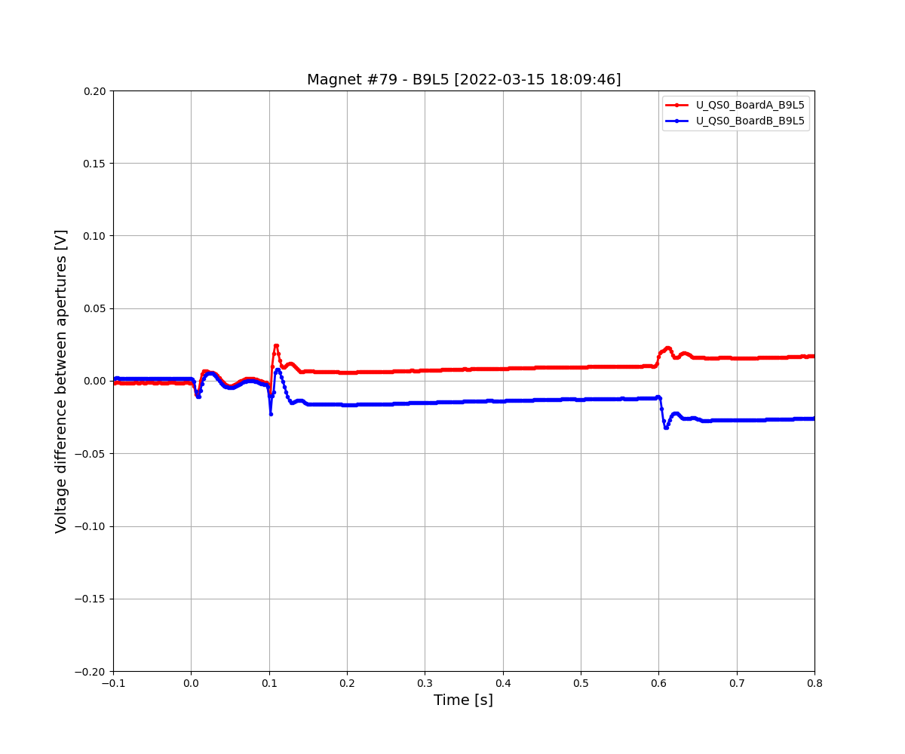
50%
38%
8%
2%
5%
>35000 signals

Slide 3
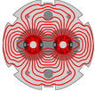
Safe
Reliable
Available
LHC

Slide 4
Reduce as much as possible the risk of operating RB circuits
Understand the RB circuit and MB magnet behavior
Predict the effect of hardware changes, operation scenarios, failure cases, etc
Analyze unexpected transients
Look for eventual precursors of failures

Slide 5
Strategy to identify MB magnets with potential issues
Frequency domain analysis
Monitor
Metadata
Time domain analysis
Simulate

Slide 6
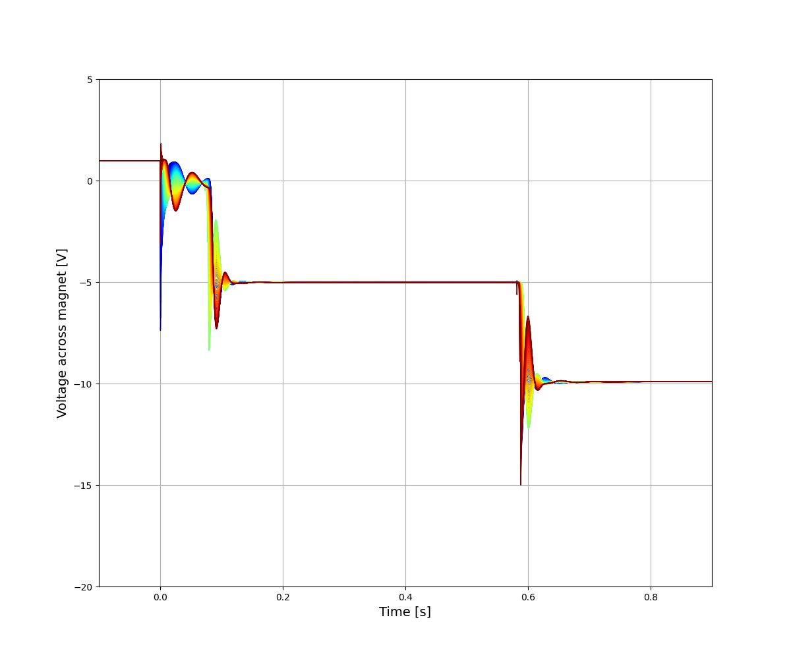
Fast Power Abort (FPA) “Snapshot” test in the RB circuit
Three events
PC switching off
EE1 opening
EE2 opening
1
2
3

Slide 7
1. Power converter ringing
Main features
Voltage across PC:
Inductive voltage N_mag*L_mag*dI/dt ~0-150 V
Resistive voltage
R_warm*I ~2-11 V
Oscillating frequency → ~20 Hz
Oscillating frequency and damping dominated by PC filter
1

Slide 8
2-3. 1st and 2nd energy-extraction switch openings
Main features
Voltage across EE:
R_EE*I ~0-750 V
Oscillating frequency → ~20 Hz
Oscillating frequency and damping dominated by magnet circuit
2
3

Slide 9
CLASSIFY
MONITOR
SIMULATE
METADATA

Slide 10
A. CLASSIFY
0. “Normal” magnets
“Unbalanced” magnets
“Slow unbalanced” magnets a.k.a. “outlier” magnets
“Sudden offset” magnets
“Different board A/B” magnets
List of FPA Snapshot tests [by Zinur] https://twiki.cern.ch/twiki/bin/viewauth/MP3/FPAinRB
For the most curious colleagues, all plots are here \\cern.ch\dfs\projects\lhccm\MP3_day_2022

Slide 11
Example of “normal” magnet
Features
A few bumps occurring after PC switching off
A few bumps after each EE
Flat, zero signal otherwise
1
2
3

Slide 12
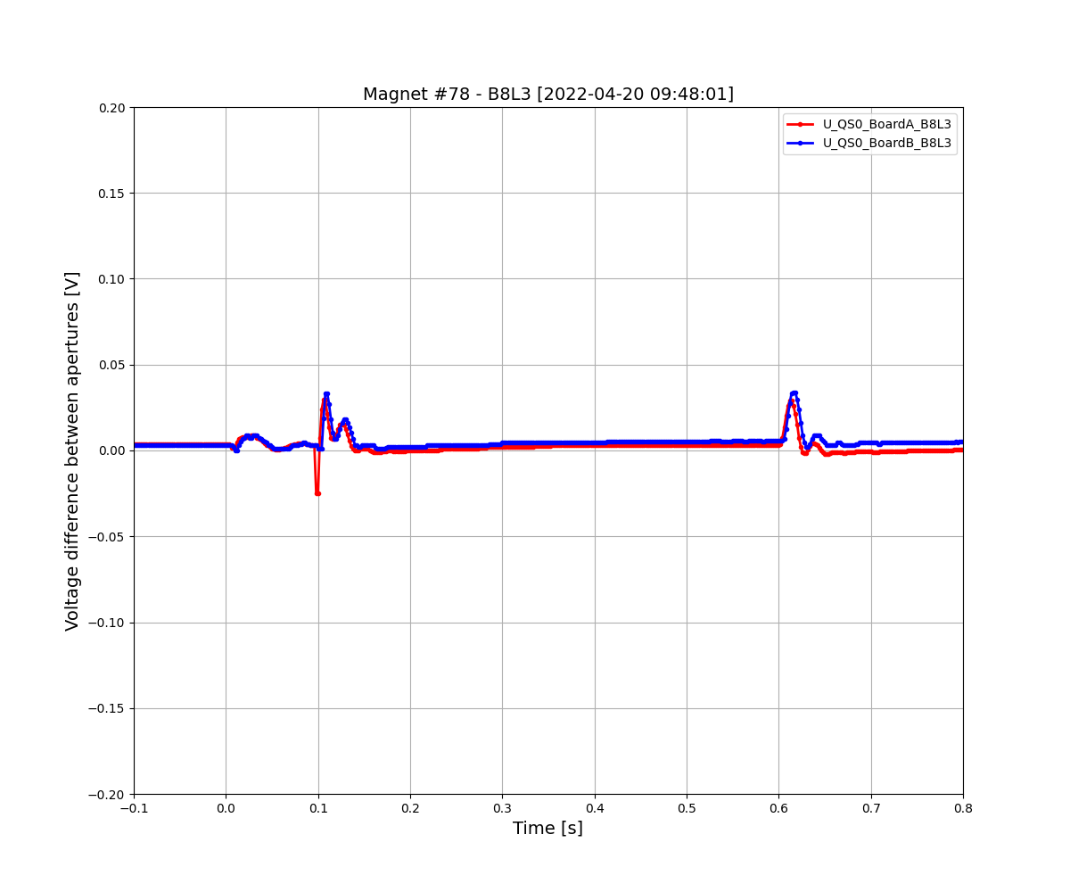
Example of “normal” magnet
Features
A few bumps occurring after PC switching off
A few bumps after each EE
Flat, zero signal otherwise
1
2
3

Slide 13
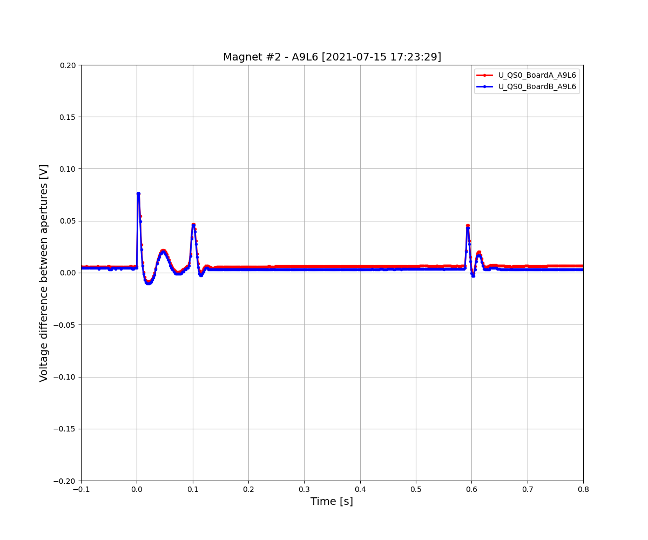
Example of “unbalanced” magnet
Features
Signal appears after PC off
Amplitude is highest at 2 kA, almost zero at 11 kA
Signal decays with short time constant (tens ms)
Can be positive/negative
Strongly correlated with thickness of Cu layer of the beam screen (eddy currents)

Slide 14
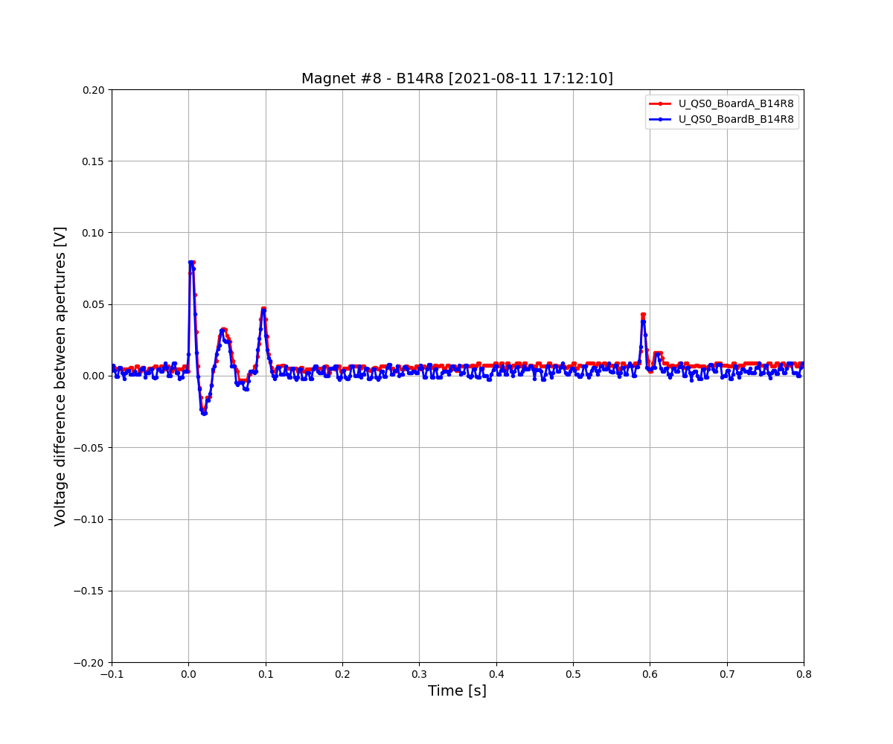
Example of “unbalanced” magnet
Features
Signal appears after PC off
Amplitude is highest at 2 kA, almost zero at 11 kA
Signal decays with short time constant (tens ms)
Can be positive/negative
Strongly correlated with thickness of Cu layer of the beam screen (eddy currents)

Slide 15
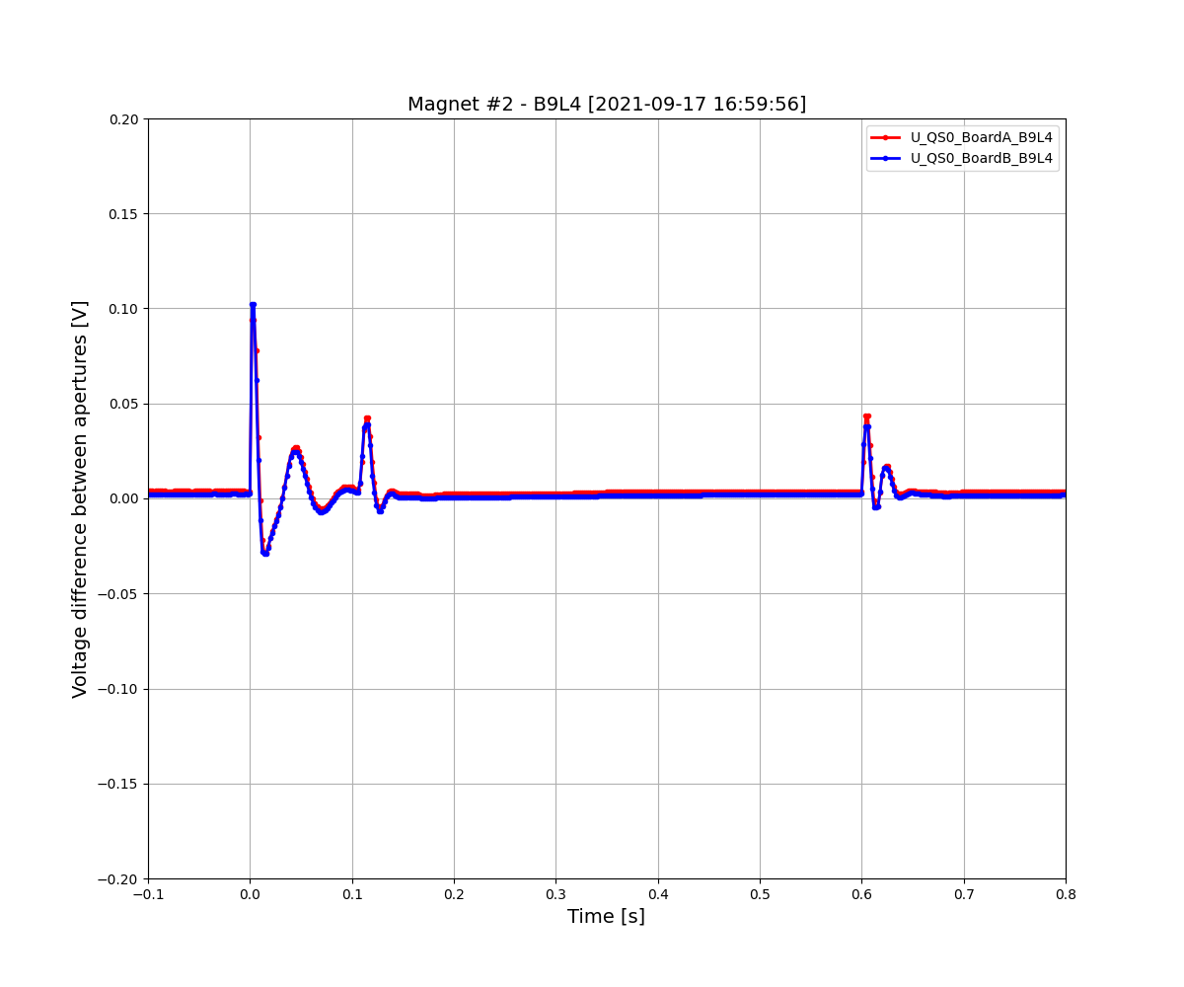
Example of “unbalanced” magnet
Features
Signal appears after PC off
Amplitude is highest at 2 kA, almost zero at 11 kA
Signal decays with short time constant (tens ms)
Can be positive/negative
Strongly correlated with thickness of Cu layer of the beam screen (eddy currents)

Slide 16
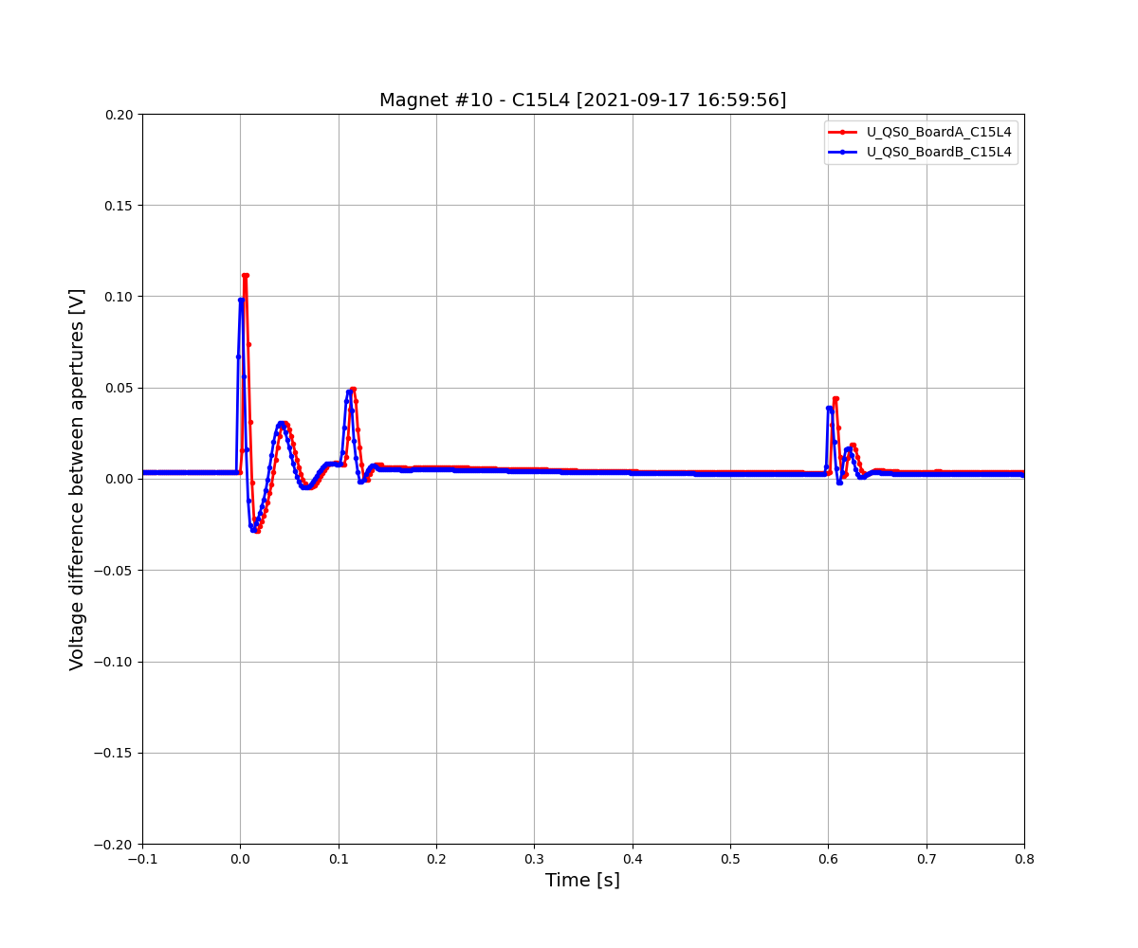
Example of “unbalanced” magnet
Features
Signal appears after PC off
Amplitude is highest at 2 kA, almost zero at 11 kA
Signal decays with short time constant (tens ms)
Can be positive/negative
Strongly correlated with thickness of Cu layer of the beam screen (eddy currents)

Slide 17
Example of “unbalanced” magnet
Features
Signal appears after PC off
Amplitude is highest at 2 kA, almost zero at 11 kA
Signal decays with short time constant (tens ms)
Can be positive/negative
Strongly correlated with thickness of Cu layer of the beam screen (eddy currents)

Slide 18
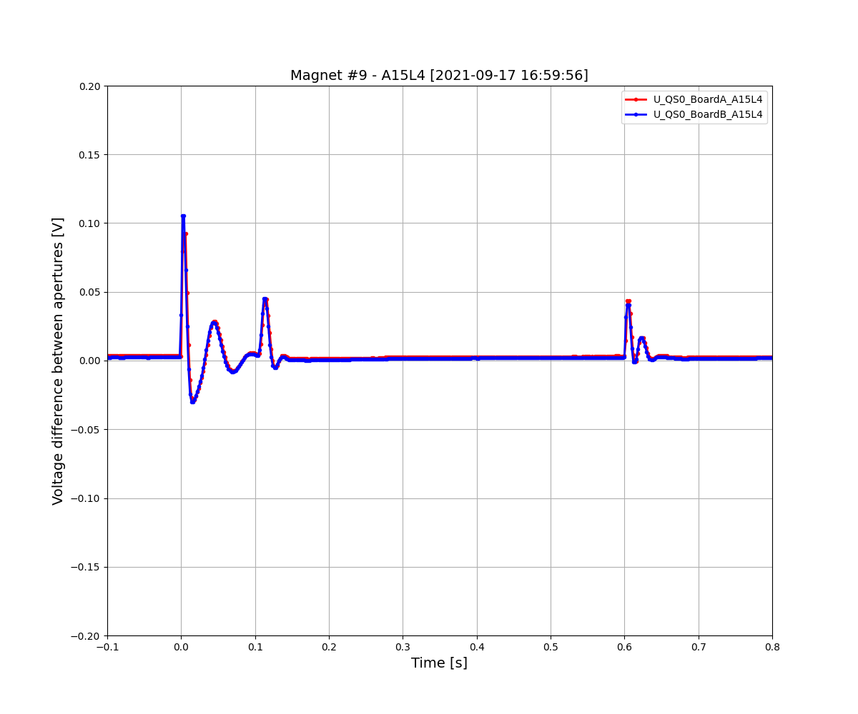
Example of “unbalanced” magnet
Features
Signal appears after PC off
Amplitude is highest at 2 kA, almost zero at 11 kA
Signal decays with short time constant (tens ms)
Can be positive/negative
Strongly correlated with thickness of Cu layer of the beam screen (eddy currents)

Slide 19
“Unbalanced” magnets
After >10 years, we understand that this behavior is due to eddy currents developed in the Cu layer of the beam screen
We can correlate very well FPA measurements and frequency transfer measurements (FTM) to the Cu thickness deduced from beam screen measurements
We can model this behavior fairly well in the time and frequency domain [with a couple of things to iron out…]

Slide 20
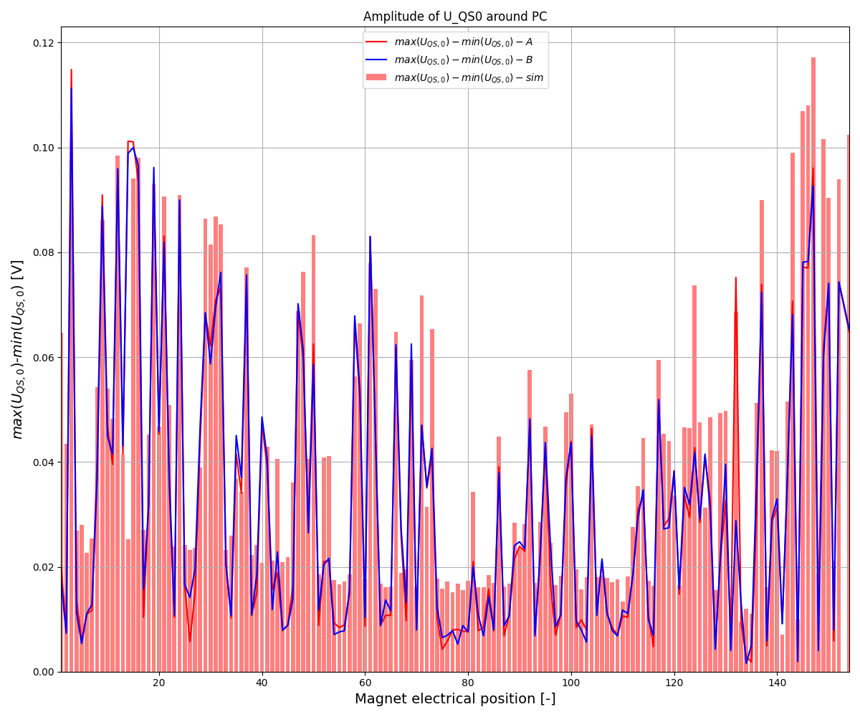
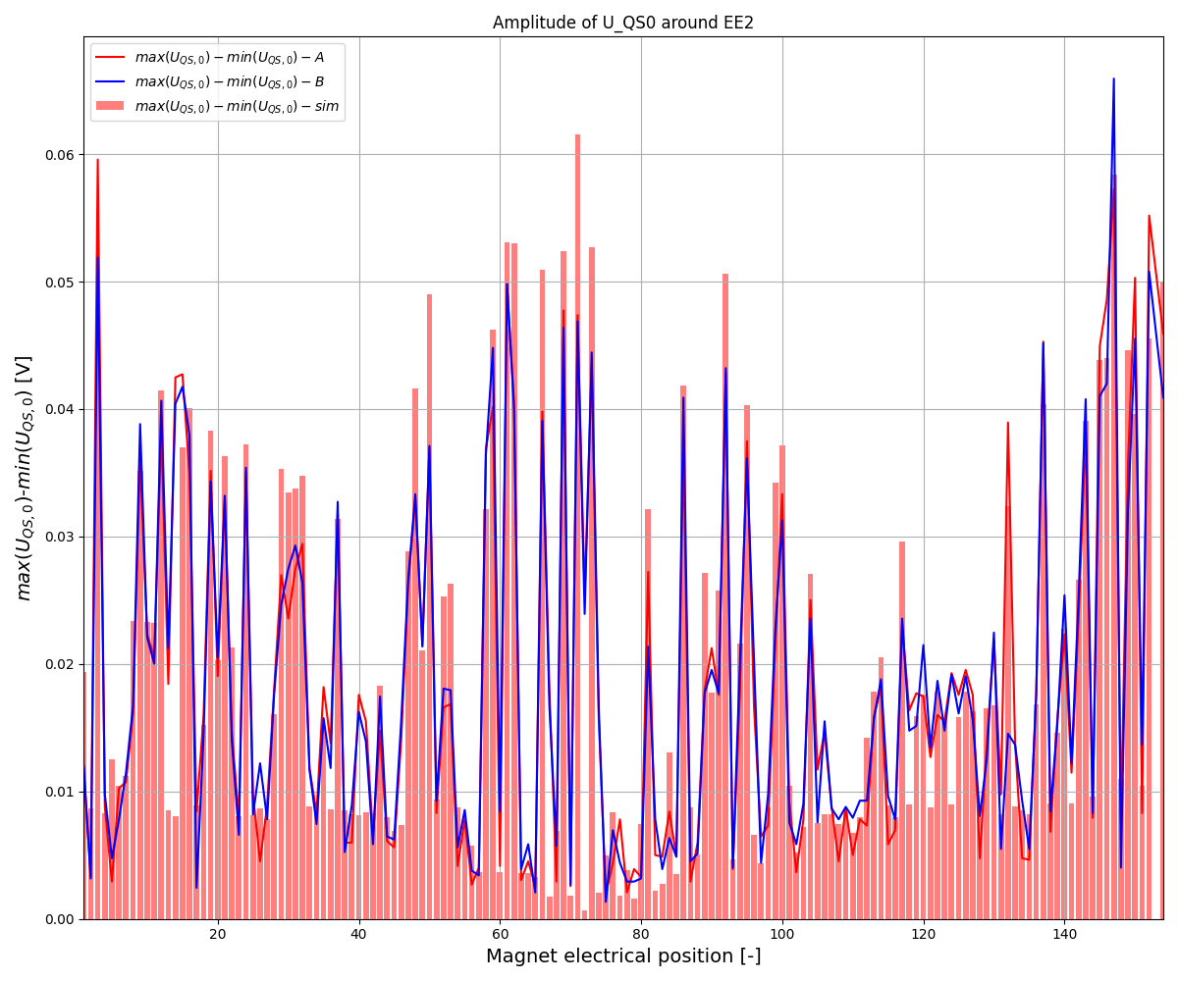
Comparison of meas and sim max(U_QS0)-min(U_QS0) @2 kA, 10 A/s
During PC switching off
During EE2 opening

Slide 21
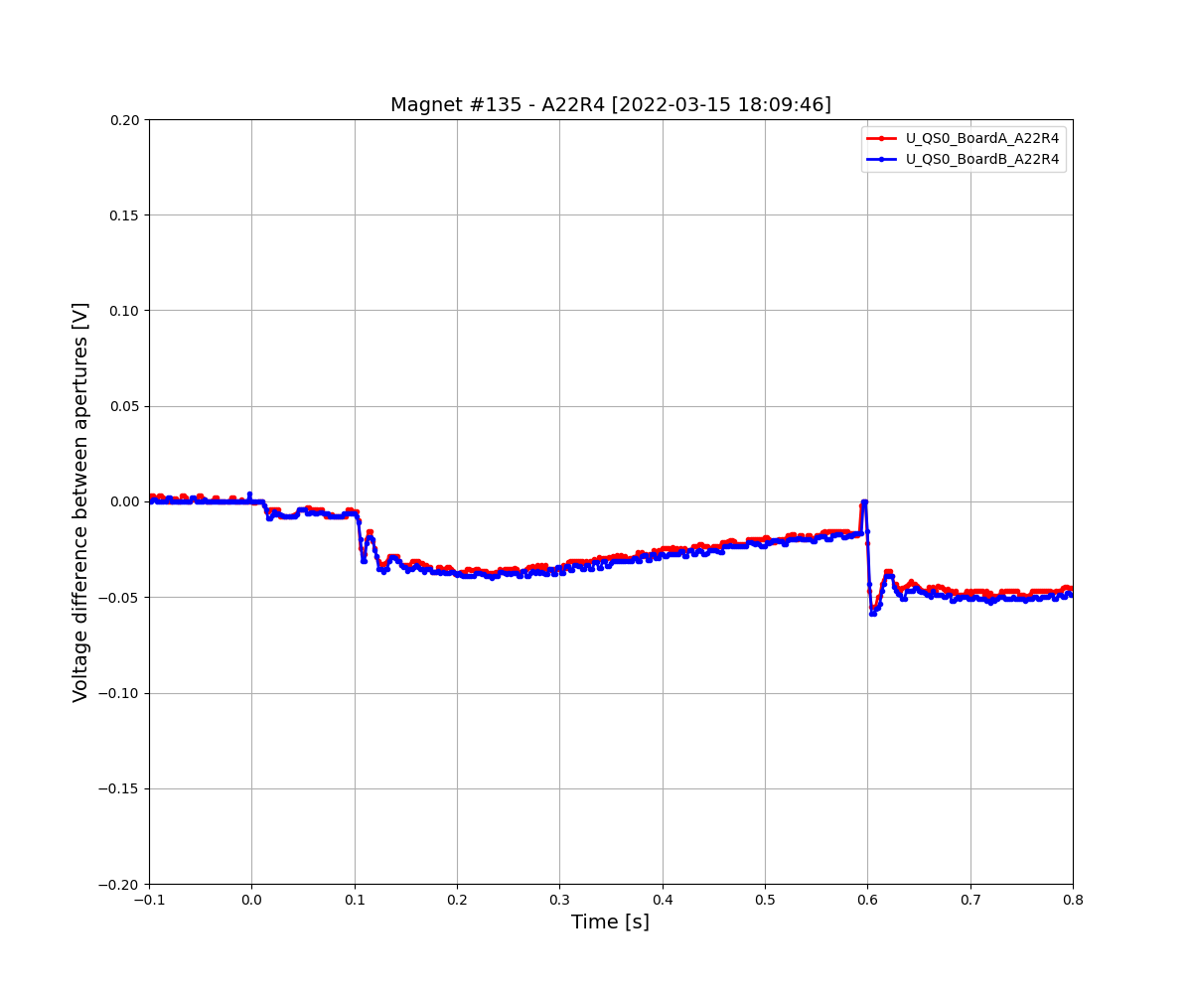
Example of “Slow unbalanced” magnet
Features
Signal appears after EE
Amplitude scales with current
Signal decays with long time constant (hundreds ms)
Can be positive/negative

Slide 22
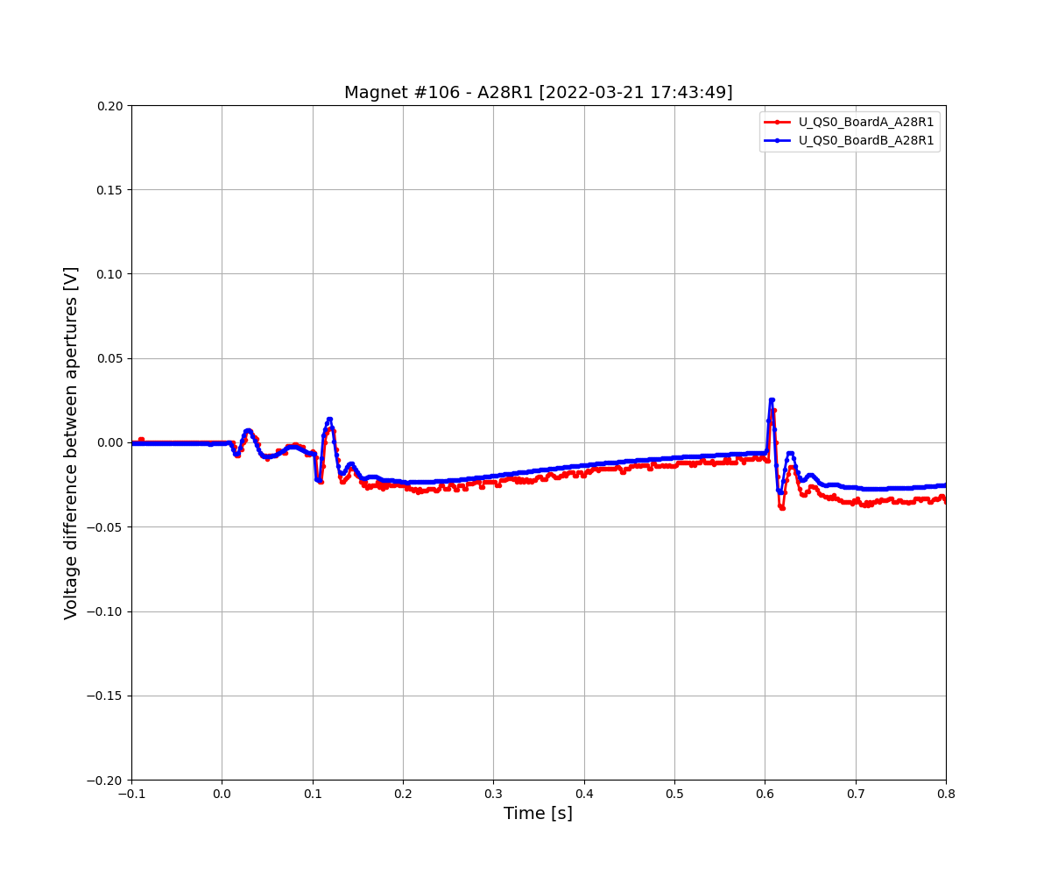
Example of “Slow unbalanced” magnet
Features
Signal appears after EE
Amplitude scales with current
Signal decays with long time constant (hundreds ms)
Can be positive/negative

Slide 23
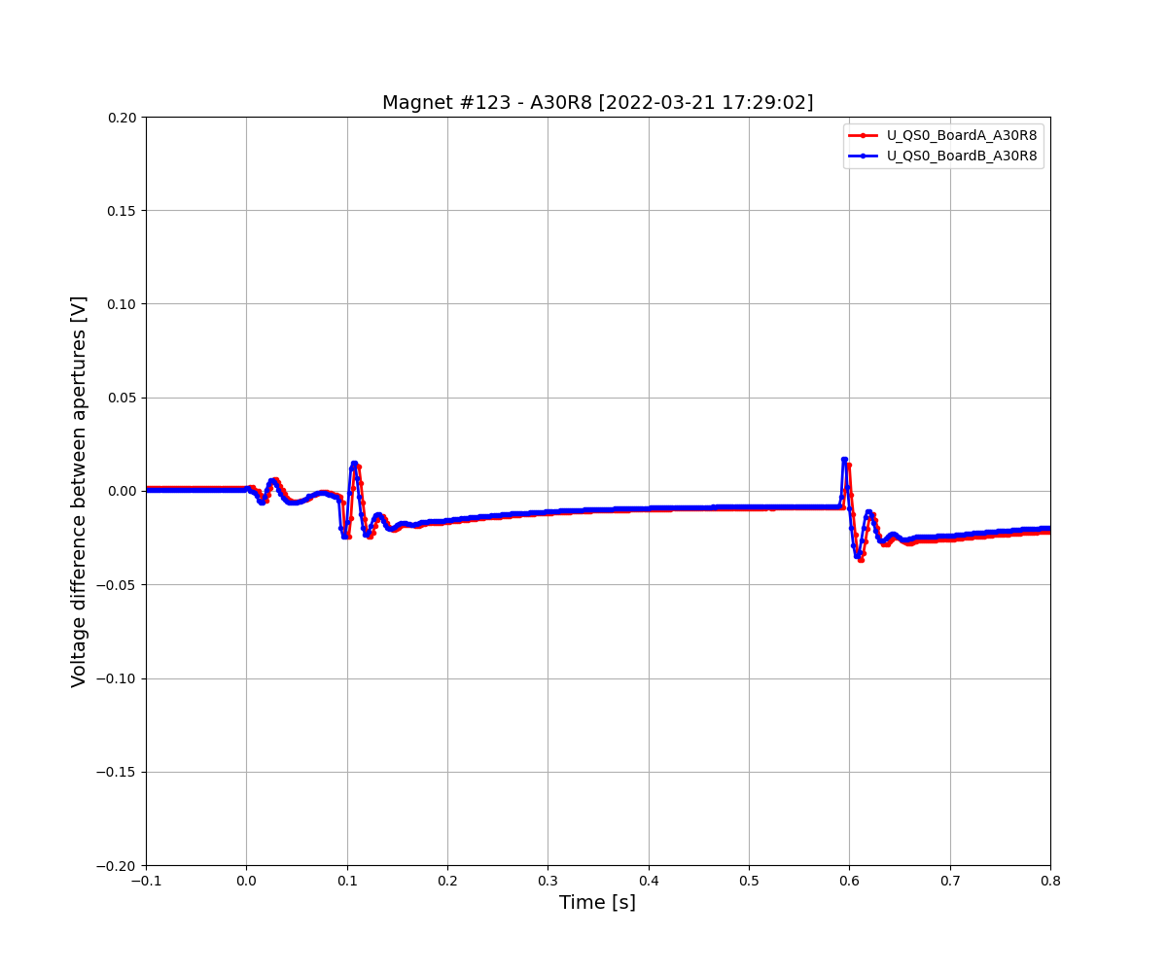
Example of “Slow unbalanced” magnet
Features
Signal appears after EE
Amplitude scales with current
Signal decays with long time constant (hundreds ms)
Can be positive/negative

Slide 24
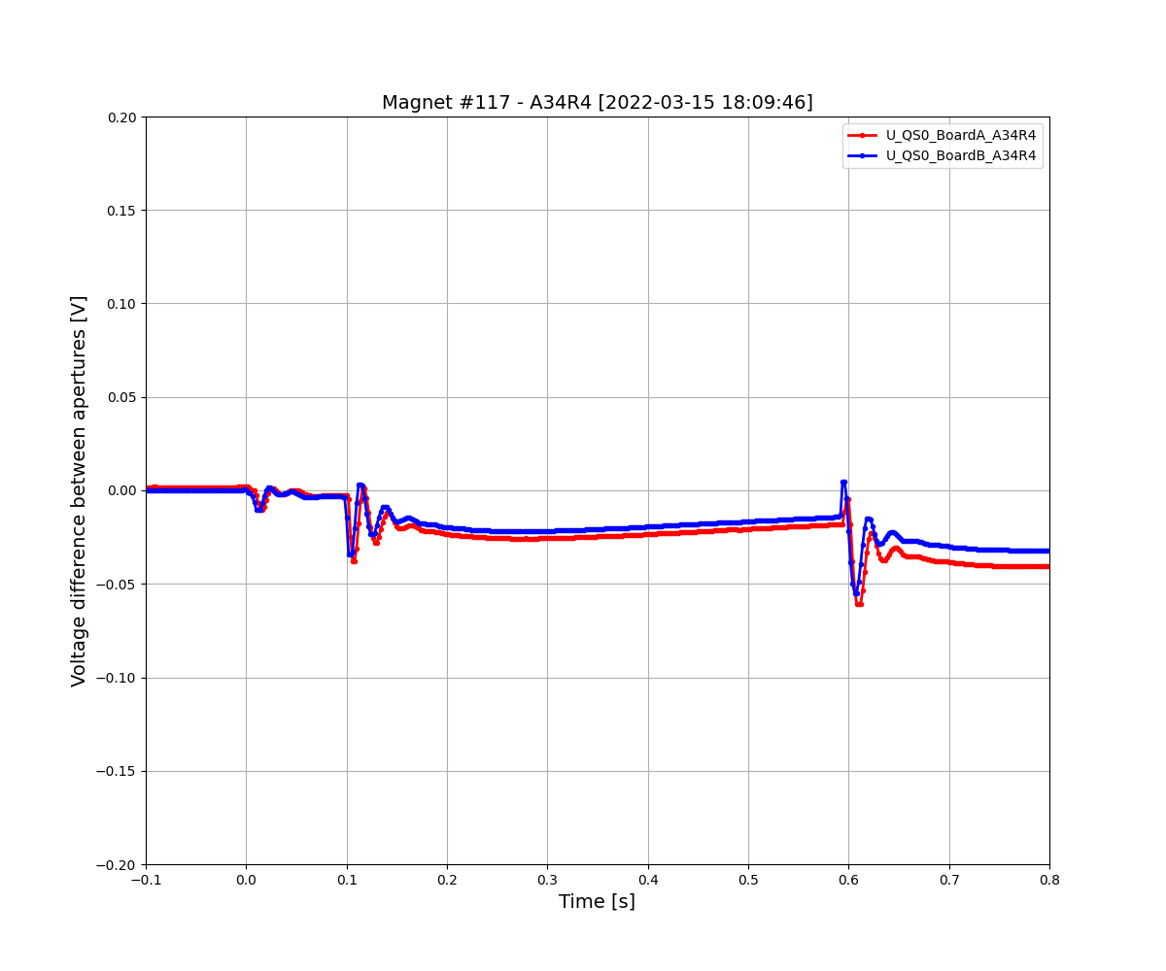
Example of “Slow unbalanced” magnet
Features
Signal appears after EE
Amplitude scales with current
Signal decays with long time constant (hundreds ms)
Can be positive/negative

Slide 25
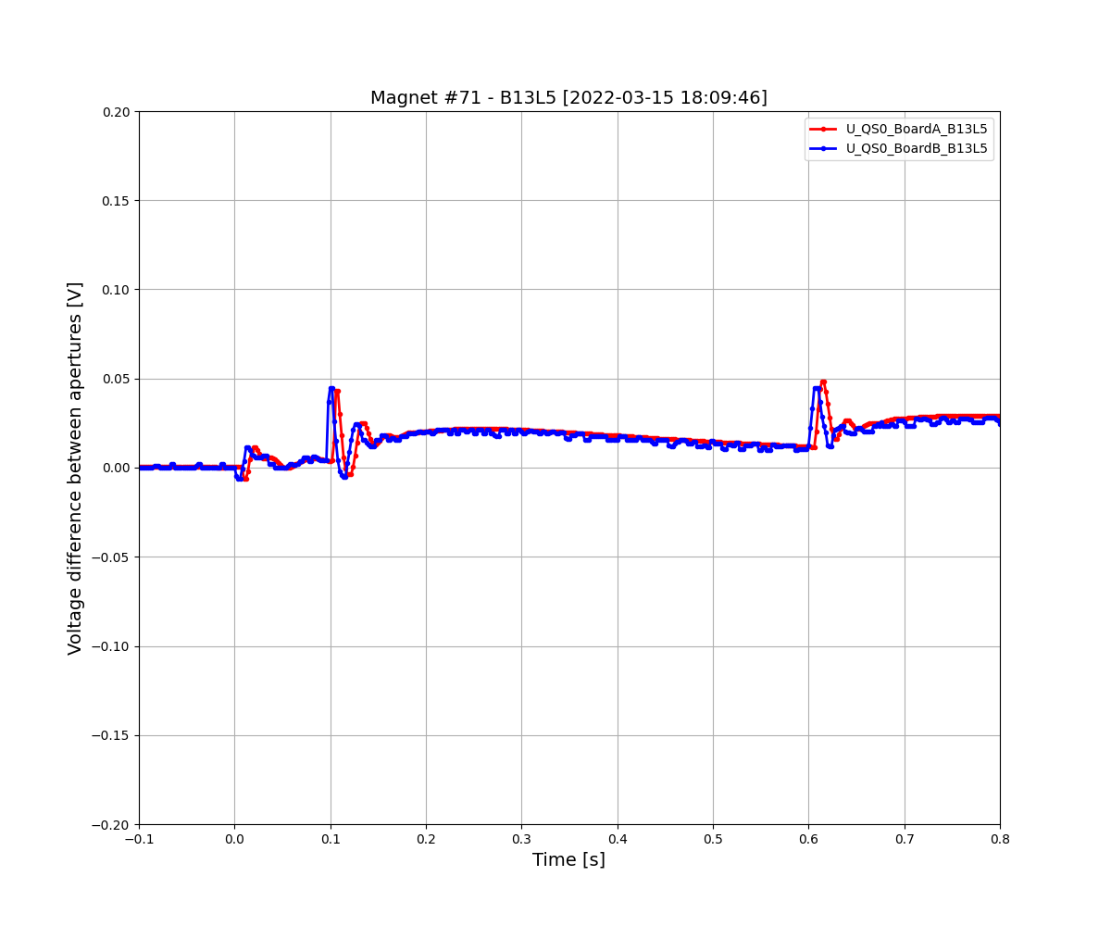
Example of “Slow unbalanced” magnet
Features
Signal appears after EE
Amplitude scales with current
Signal decays with long time constant (hundreds ms)
Can be positive/negative

Slide 26
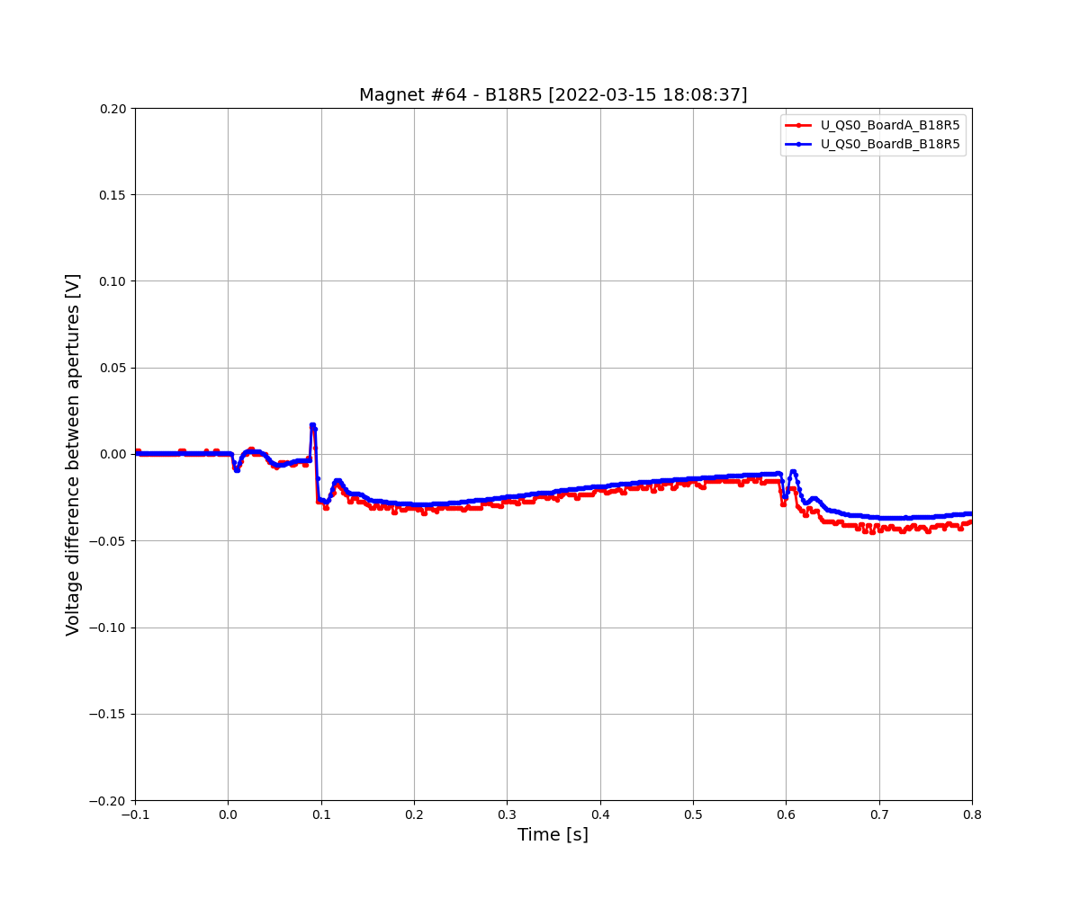
Example of “Slow unbalanced” magnet
Features
Signal appears after EE
Amplitude scales with current
Signal decays with long time constant (hundreds ms)
Can be positive/negative

Slide 27
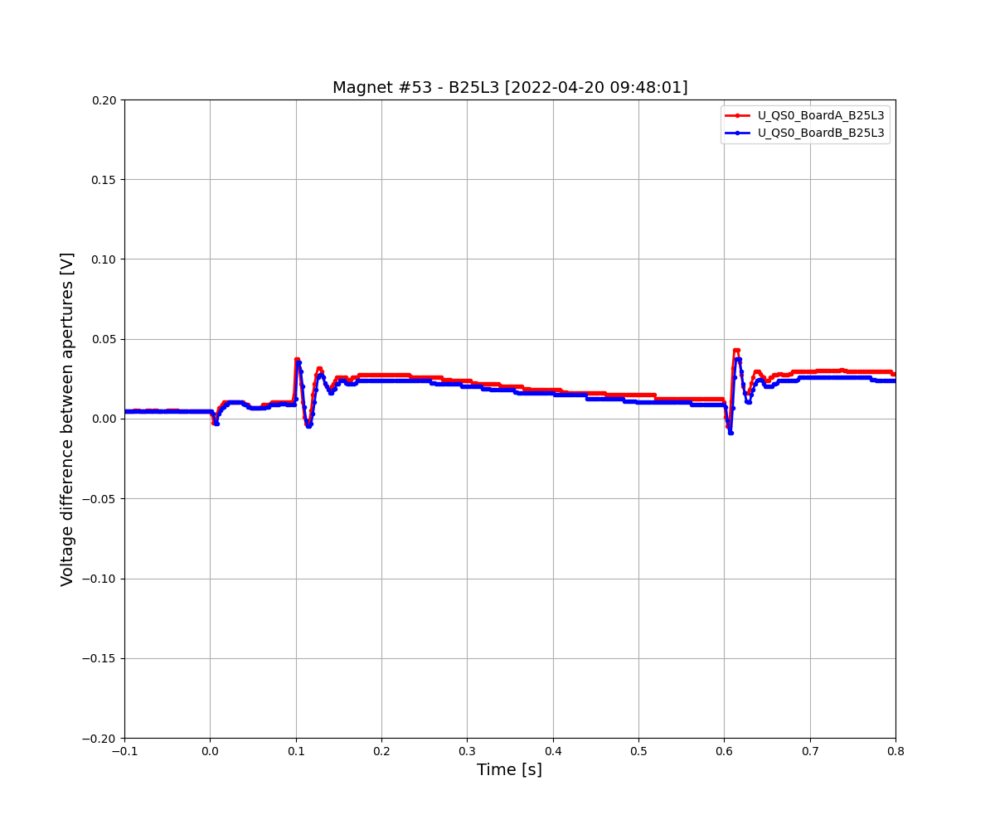
Example of “Slow unbalanced” magnet
Features
Signal appears after EE
Amplitude scales with current
Signal decays with long time constant (hundreds ms)
Can be positive/negative

Slide 28
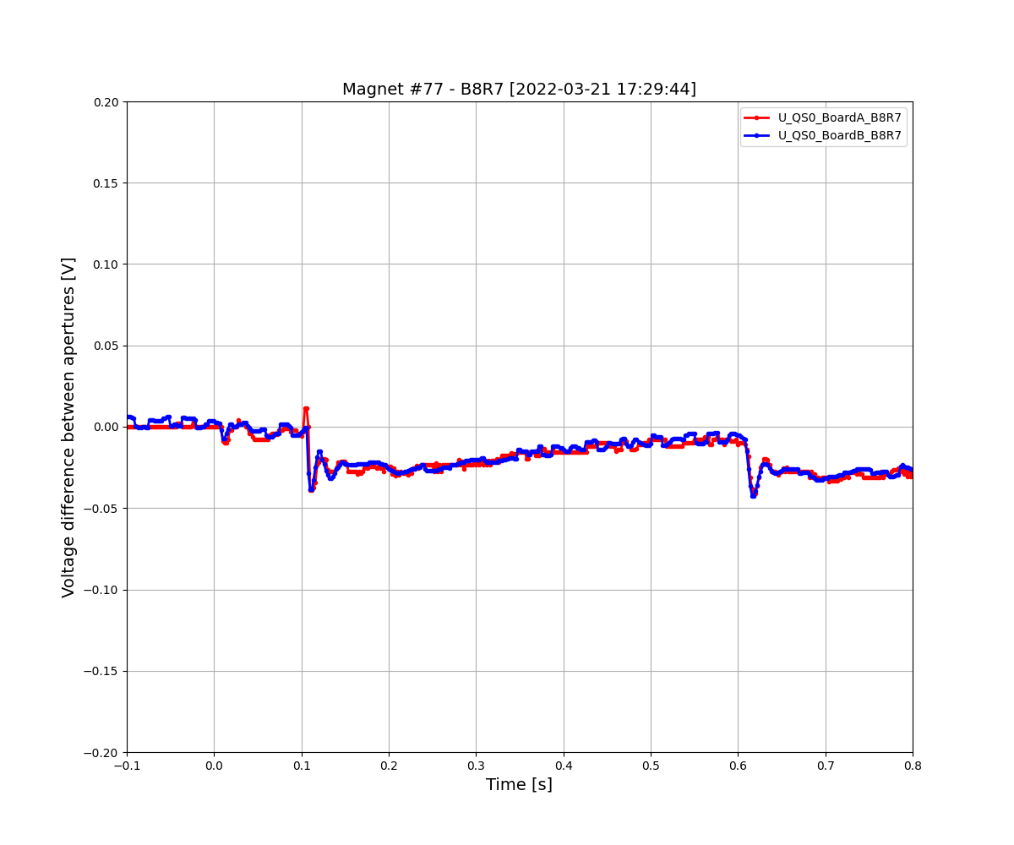
Example of “Slow unbalanced” magnet
Features
Signal appears after EE
Amplitude scales with current
Signal decays with long time constant (hundreds ms)
Can be positive/negative

Slide 29
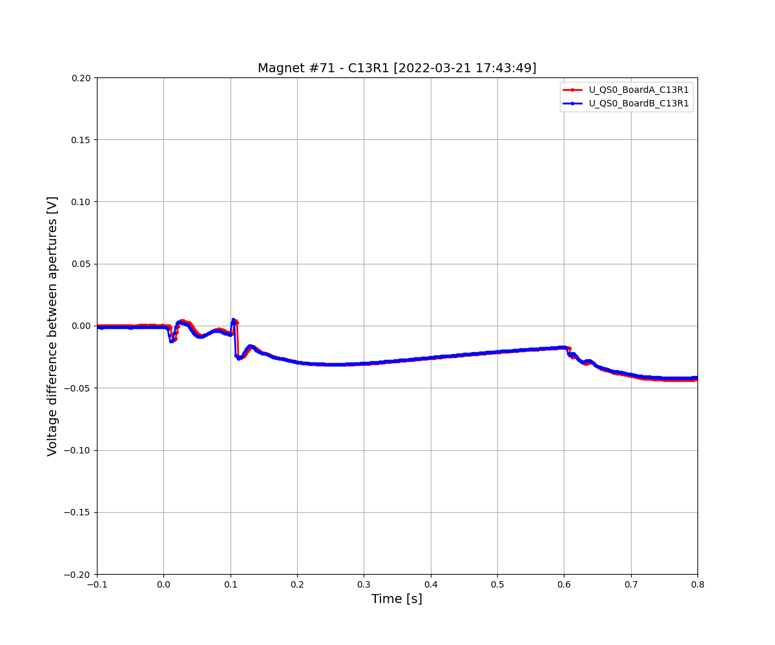
Example of “Slow unbalanced” magnet
Features
Signal appears after EE
Amplitude scales with current
Signal decays with long time constant (hundreds ms)
Can be positive/negative

Slide 30
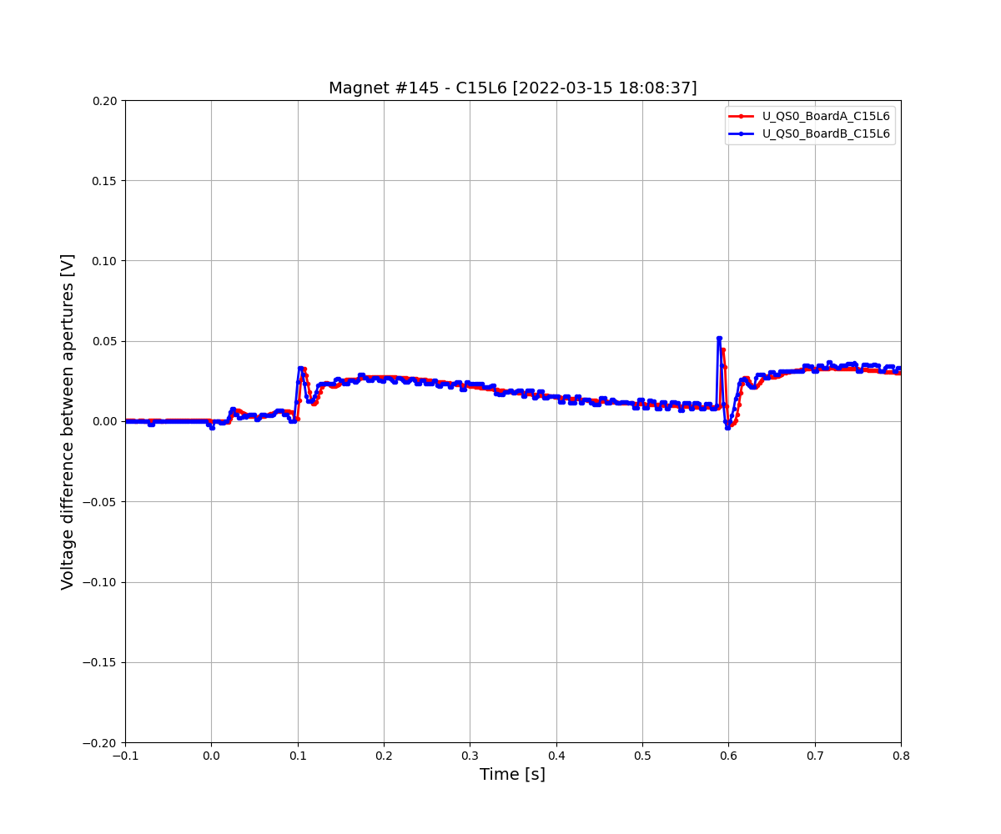
Example of “Slow unbalanced” magnet
Features
Signal appears after EE
Amplitude scales with current
Signal decays with long time constant (hundreds ms)
Can be positive/negative

Slide 31
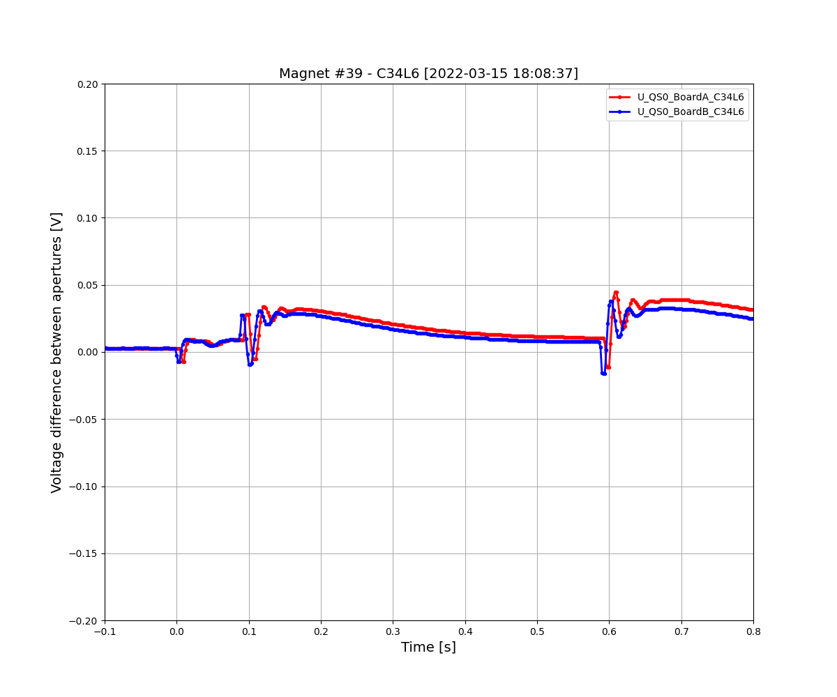
Example of “Slow unbalanced” magnet
Features
Signal appears after EE
Amplitude scales with current
Signal decays with long time constant (hundreds ms)
Can be positive/negative

Slide 32
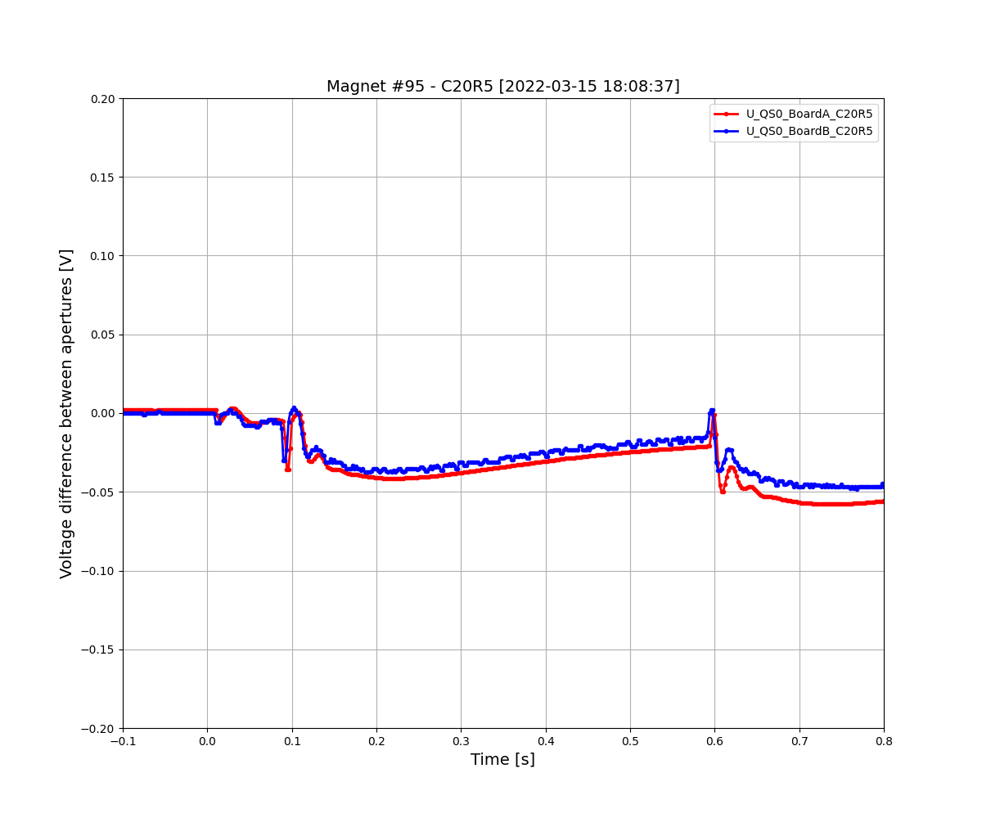
Example of “Slow unbalanced” magnet
Features
Signal appears after EE
Amplitude scales with current
Signal decays with long time constant (hundreds ms)
Can be positive/negative

Slide 33
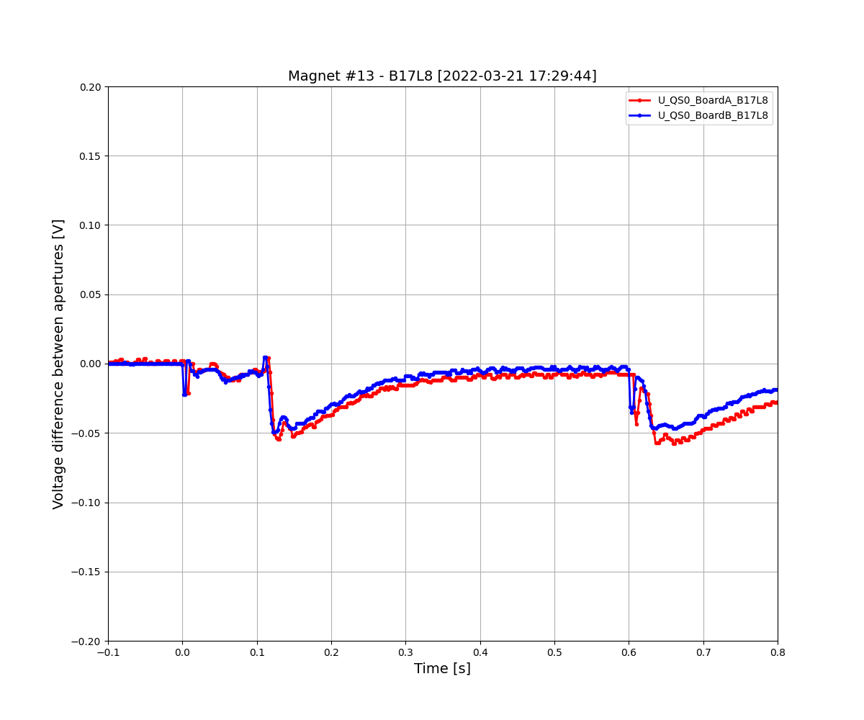
Example of “Slow unbalanced” magnet
Features
Signal appears after EE
Amplitude scales with current
Signal decays with long time constant (hundreds ms)
Can be positive/negative

Slide 34
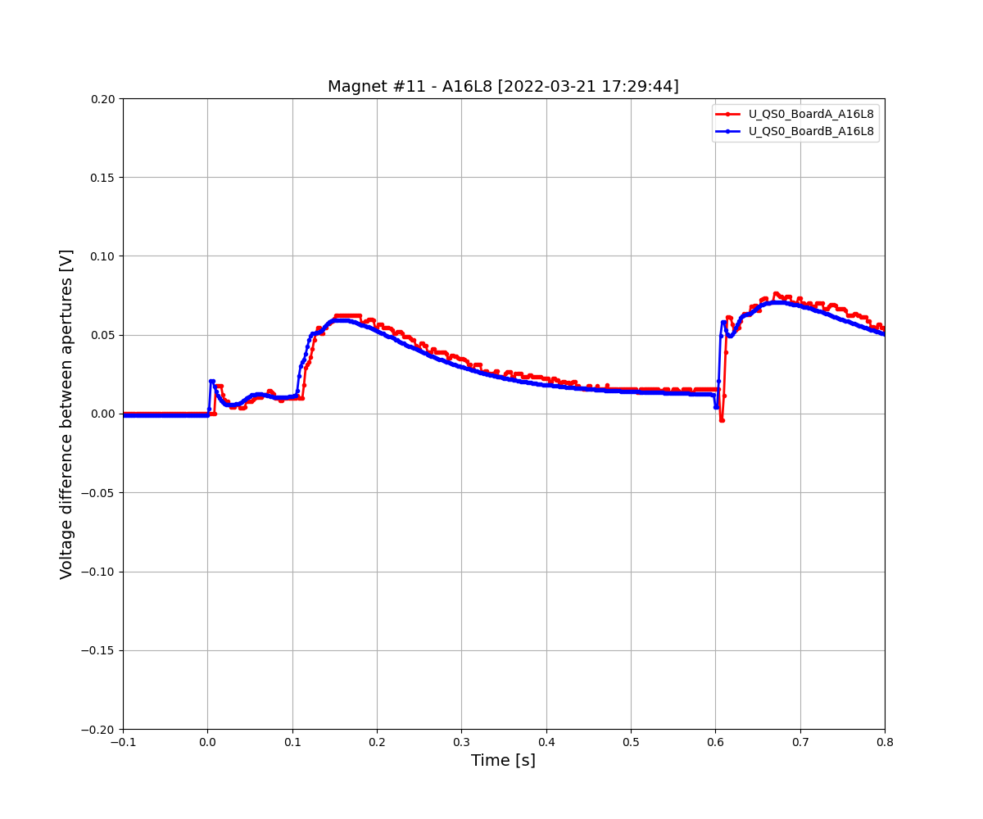
Example of “Slow unbalanced” magnet
Features
Signal appears after EE
Amplitude scales with current
Signal decays with long time constant (hundreds ms)
Can be positive/negative

Slide 35
Example of “Slow unbalanced” magnet
Features
Signal appears after EE
Amplitude scales with current
Signal decays with long time constant (hundreds ms)
Can be positive/negative
Critical, increased threshold
[MB1007, old B30R7]
See MB1007 on twiki

Slide 36
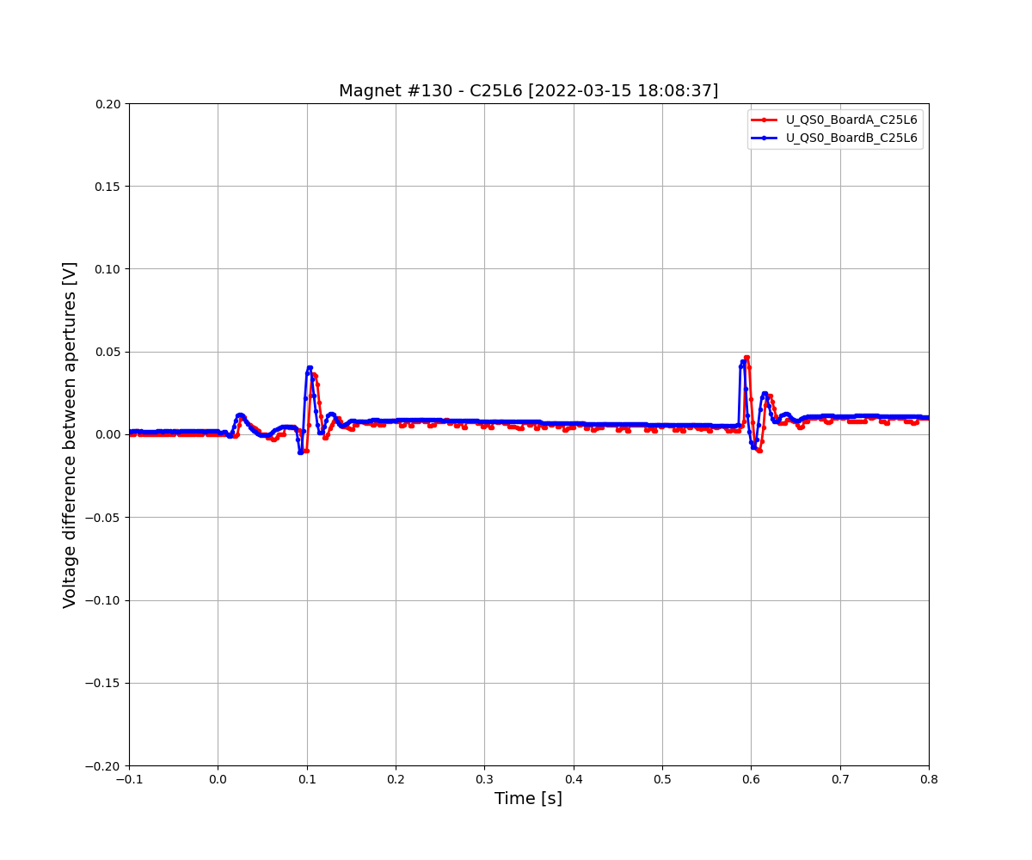
Example of “Sudden offset” magnet
Features
Signal appears after EE
Amplitude scales with current
Signal decays with very long time constant (seconds)
Can be positive/negative

Slide 37
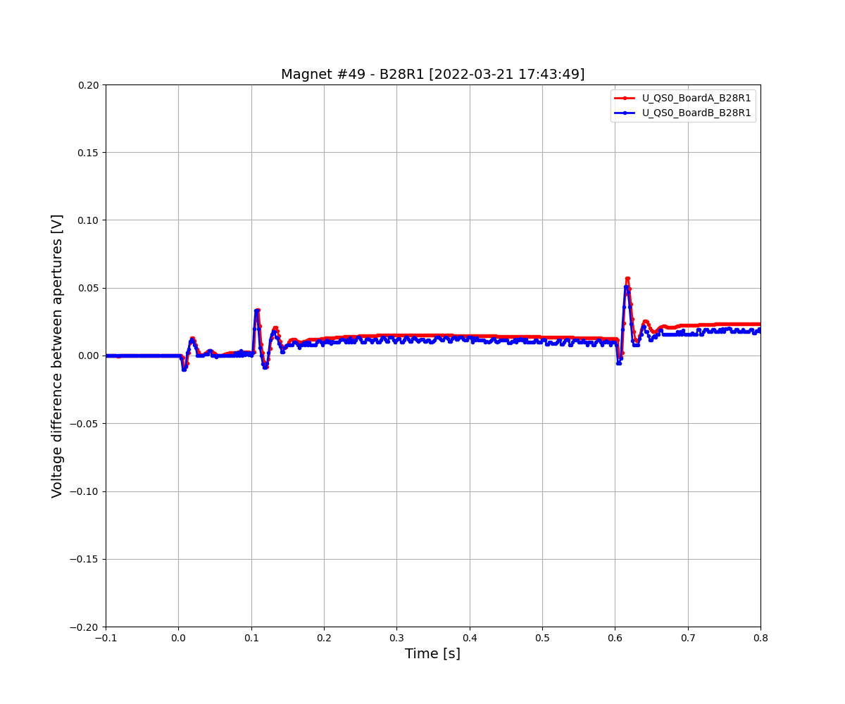
Example of “Sudden offset” magnet
Features
Signal appears after EE
Amplitude scales with current
Signal decays with very long time constant (seconds)
Can be positive/negative

Slide 38
Example of “Sudden offset” magnet
Features
Signal appears after EE
Amplitude scales with current
Signal decays with very long time constant (seconds)
Can be positive/negative

Slide 39
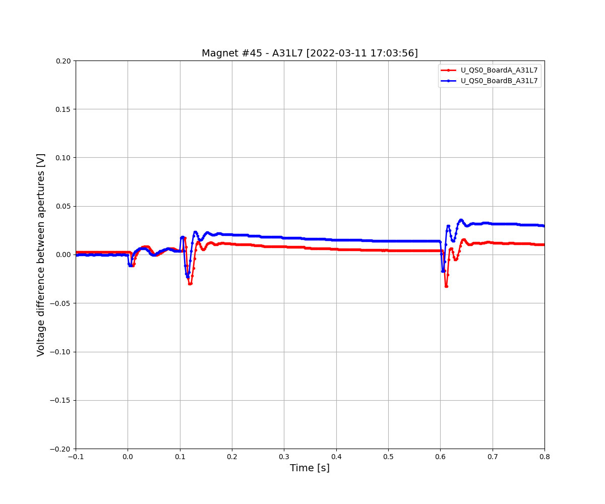
Example of “Sudden offset” magnet
Features
Signal appears after EE
Amplitude scales with current
Signal decays with very long time constant (seconds)
Can be positive/negative
Sometimes Board A/B differ

Slide 40
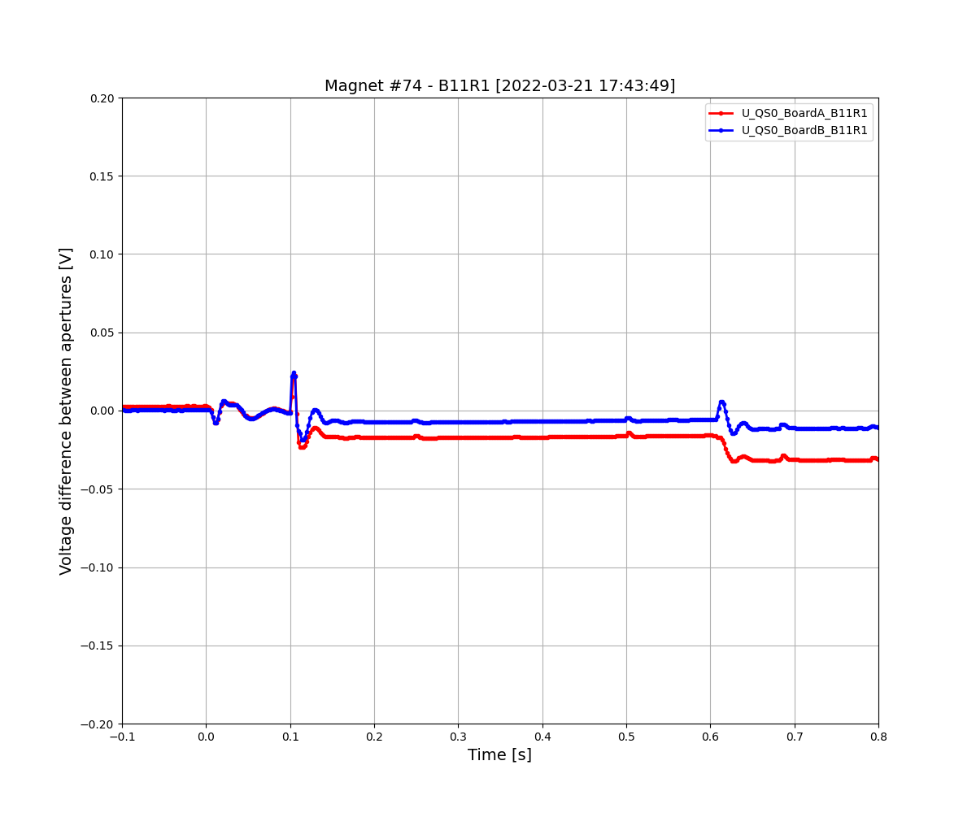
Example of “Sudden offset” magnet
Features
Signal appears after EE
Amplitude scales with current
Signal decays with very long time constant (seconds)
Can be positive/negative
Sometimes Board A/B differ

Slide 41
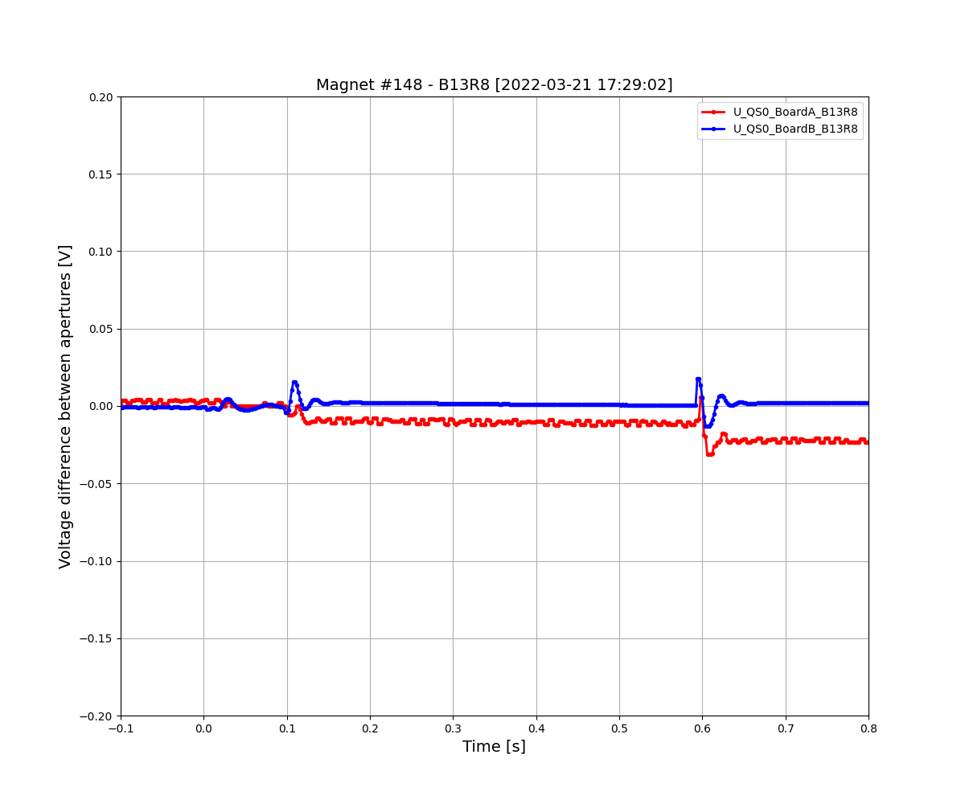
Example of “Different board A/B” magnet
Features
Signal appears after EE
Amplitude scales with current
Can be positive/negative

Slide 42
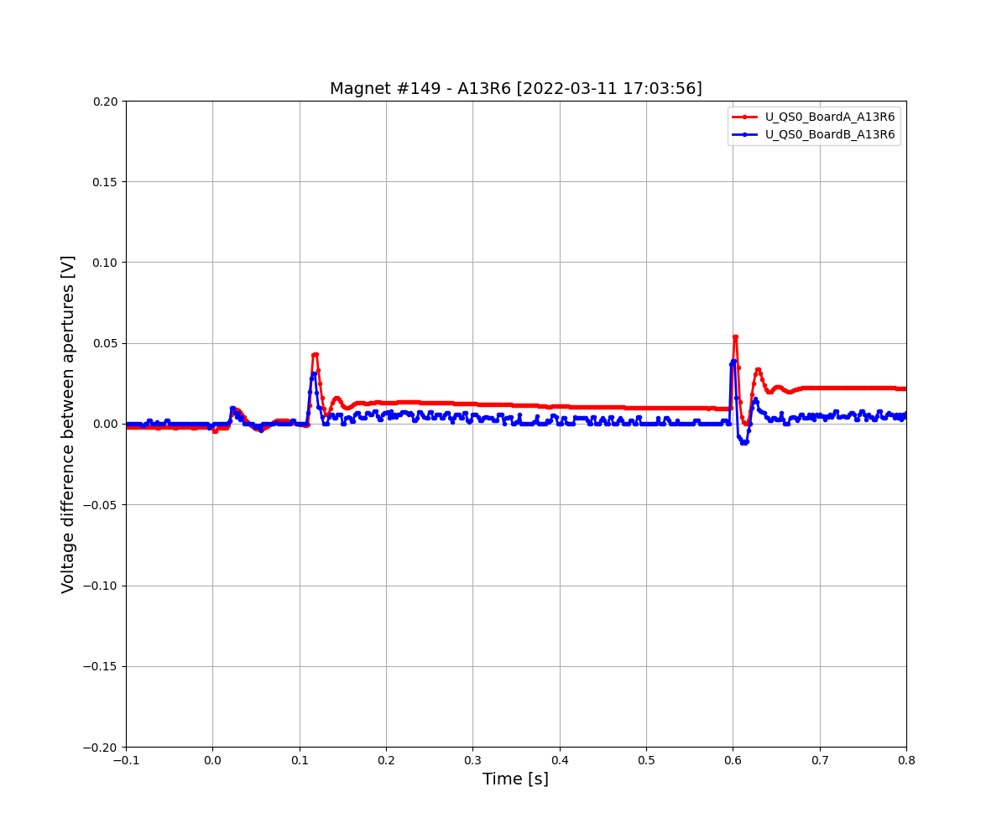
Example of “Different board A/B” magnet
Features
Signal appears after EE
Amplitude scales with current
Can be positive/negative

Slide 43
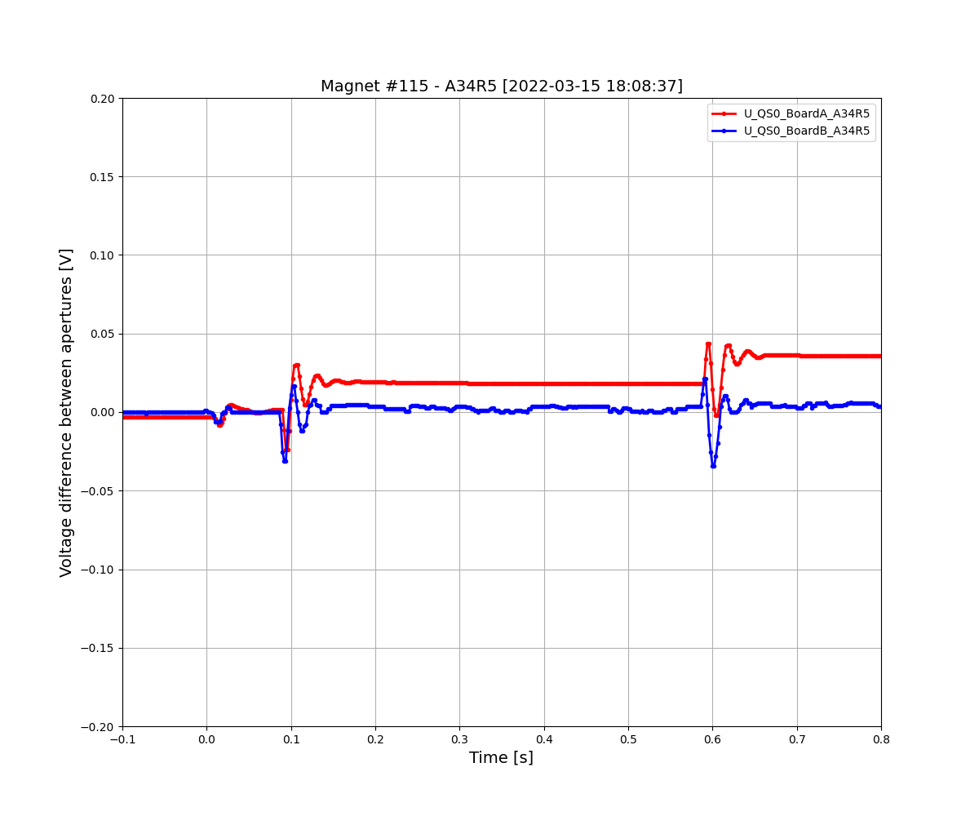
Example of “Different board A/B” magnet
Features
Signal appears after EE
Amplitude scales with current
Can be positive/negative

Slide 44
Example of “Different board A/B” magnet
Features
Signal appears after EE
Amplitude scales with current
Can be positive/negative

Slide 45
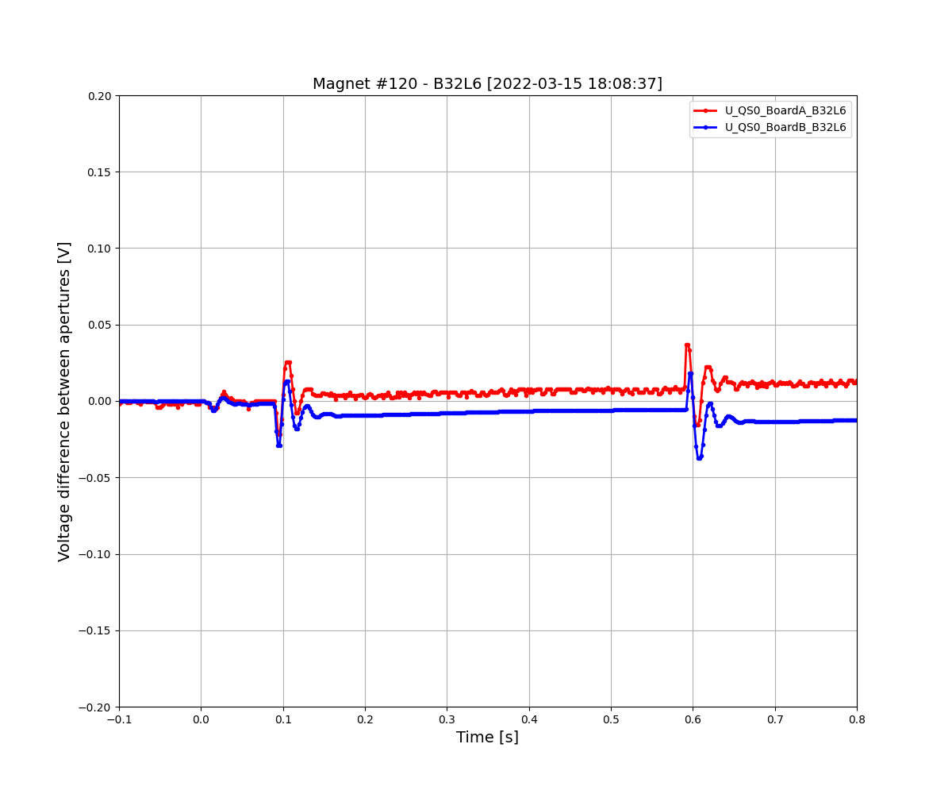
Example of “Different board A/B” magnet
Features
Signal appears after EE
Amplitude scales with current
Can be positive/negative
Sometimes affects both boards differently

Slide 46
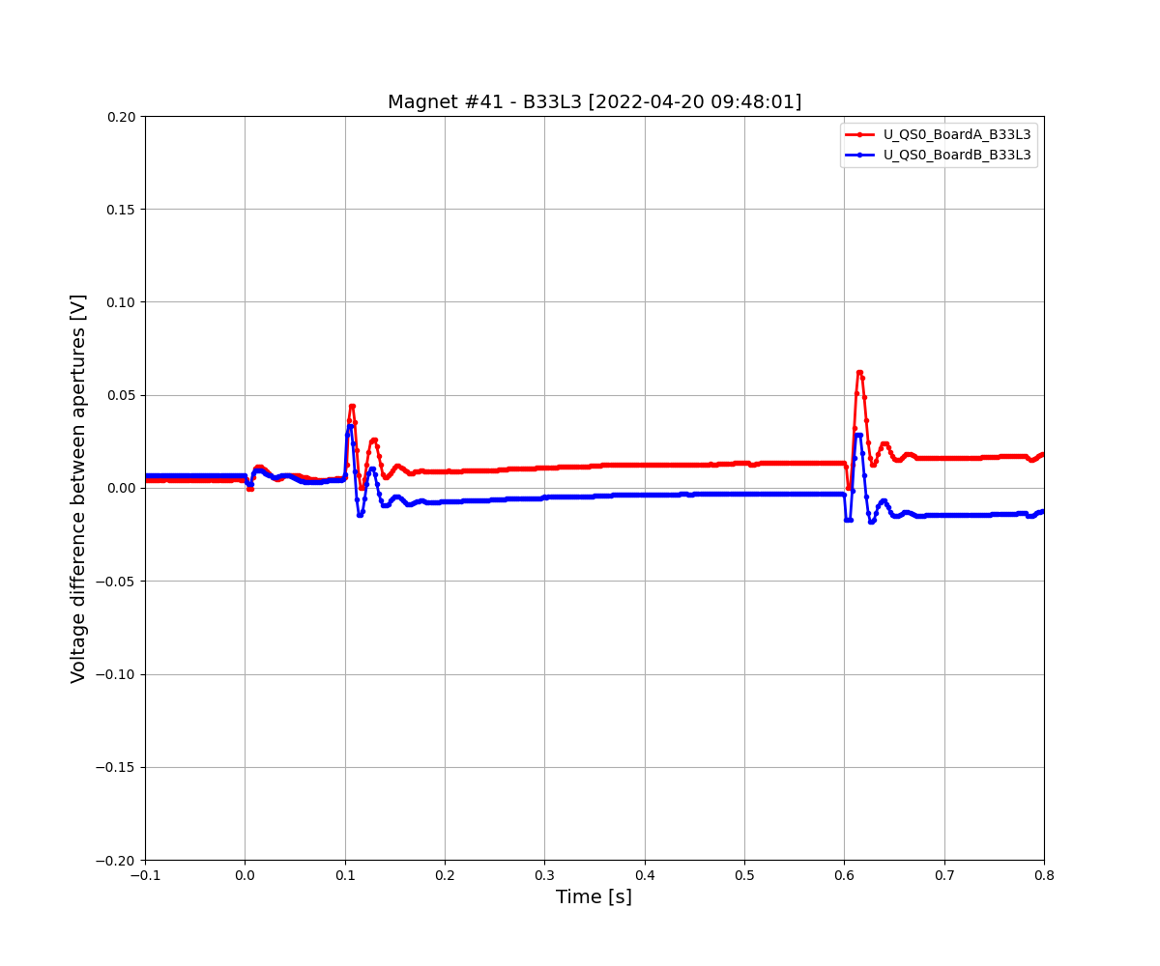
Example of “Different board A/B” magnet
Features
Signal appears after EE
Amplitude scales with current
Can be positive/negative
Sometimes affects both boards differently

Slide 47
Example of “Different board A/B” magnet
Features
Signal appears after EE
Amplitude scales with current
Can be positive/negative
Sometimes affects both boards differently

Slide 48
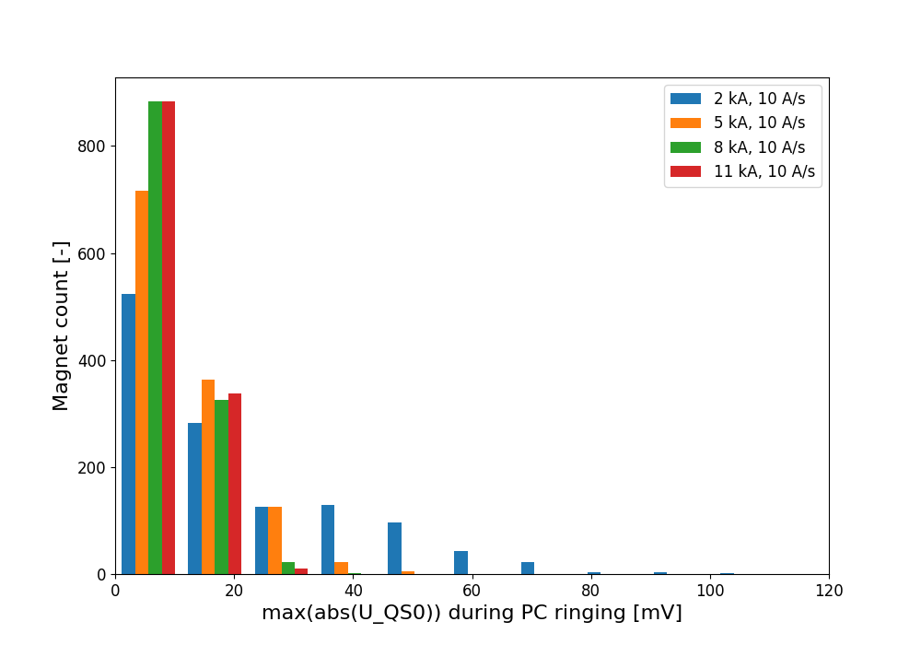
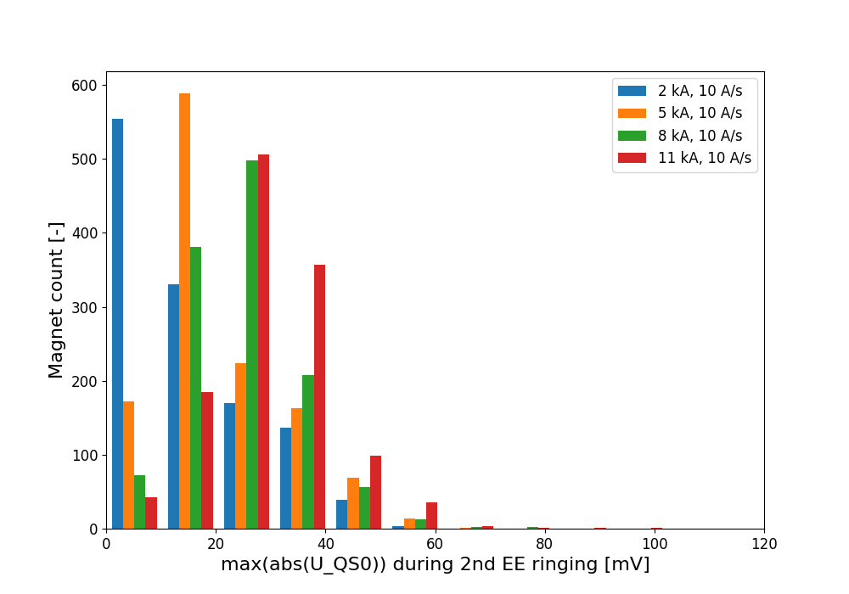
abs(max(U_QS0)) for PC switching-off and EE2 opening
“slow unbalanced” & “sudden offset” magnets
“unbalanced” magnets
During PC switching off
During EE2 opening

Slide 49
Summary of magnet classification circuit by circuit
Circuit | # Unbalanced | # Slow unbalanced | # Sudden offset | # Different board A/B
RB12 | 66 | 11 | 6 | 7
RB23 | 57 | 13 | 0 | 3
RB34 | 52 | 13 | 0 | 8
RB45 | 57 | 16 | 3 | 8
RB56 | 61 | 20 | 9 | 11
RB67 | 61 | 14 | 6 | 21
RB78 | 29 | 10 | 0 | 4
RB81 | 82 | 1 | 0 | 2
TOT | 465 | 97 | 24 | 64
Note: The classification is rather loose and only meant to give indicative figures.

Slide 50
B. MONITOR – Snapshot tests in 2014-15, 2015-16, 2018, 2021-2022
Evolution of “unbalanced” magnets (2 kA, 10 A/s)
Evolution of “slow unbalanced”, “sudden offset”, “different board A/B” magnets (10-11 kA)
Re-map circuits after magnets are changed
Look for drastically different behaviors

Slide 51
Summary of magnets changing behaviour from 2015 to 2021
Circuit | # Unbalanced | # Slow unbalanced | # Sudden offset | # Different board A/B
RB12 | 84→66 | → | → | →
RB23 | 52→57 | → | → | →
RB34 | 50→52 | → | → | →
RB45 | 56→57 | → | → | →
RB56 | 67→61 | → | → | →
RB67 | 47→61 | → | → | →
RB78 | 25→29 | → | → | →
RB81 | 75→82 | → | → | →
TOT | 456→465 | → | → | →
Note: The classification is rather loose and only meant to give indicative figures. A few tens of magnets were changed from 2015 to 2021, including 25 “unbalanced” ones.
ANALYSIS IN PROGESS, APOLOGIES

Slide 52
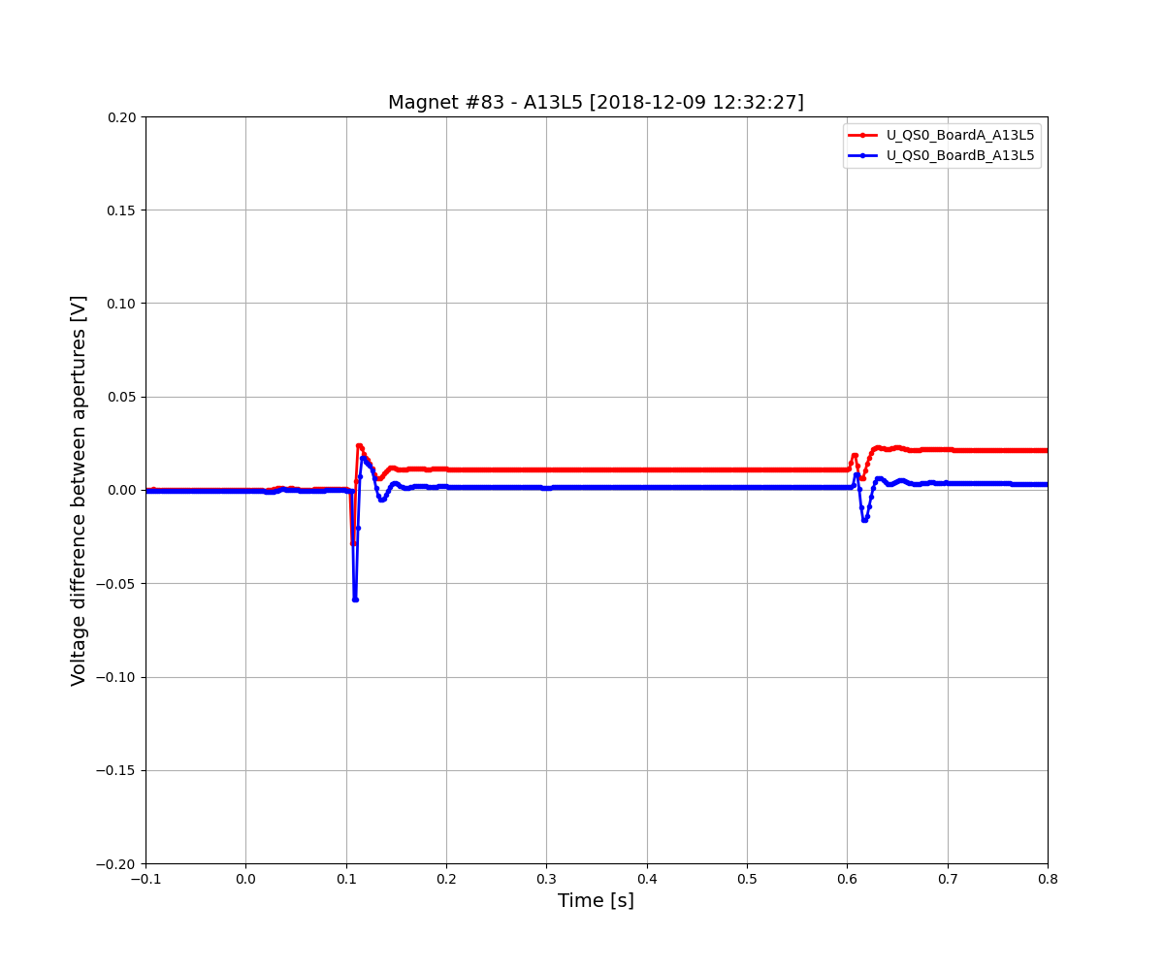
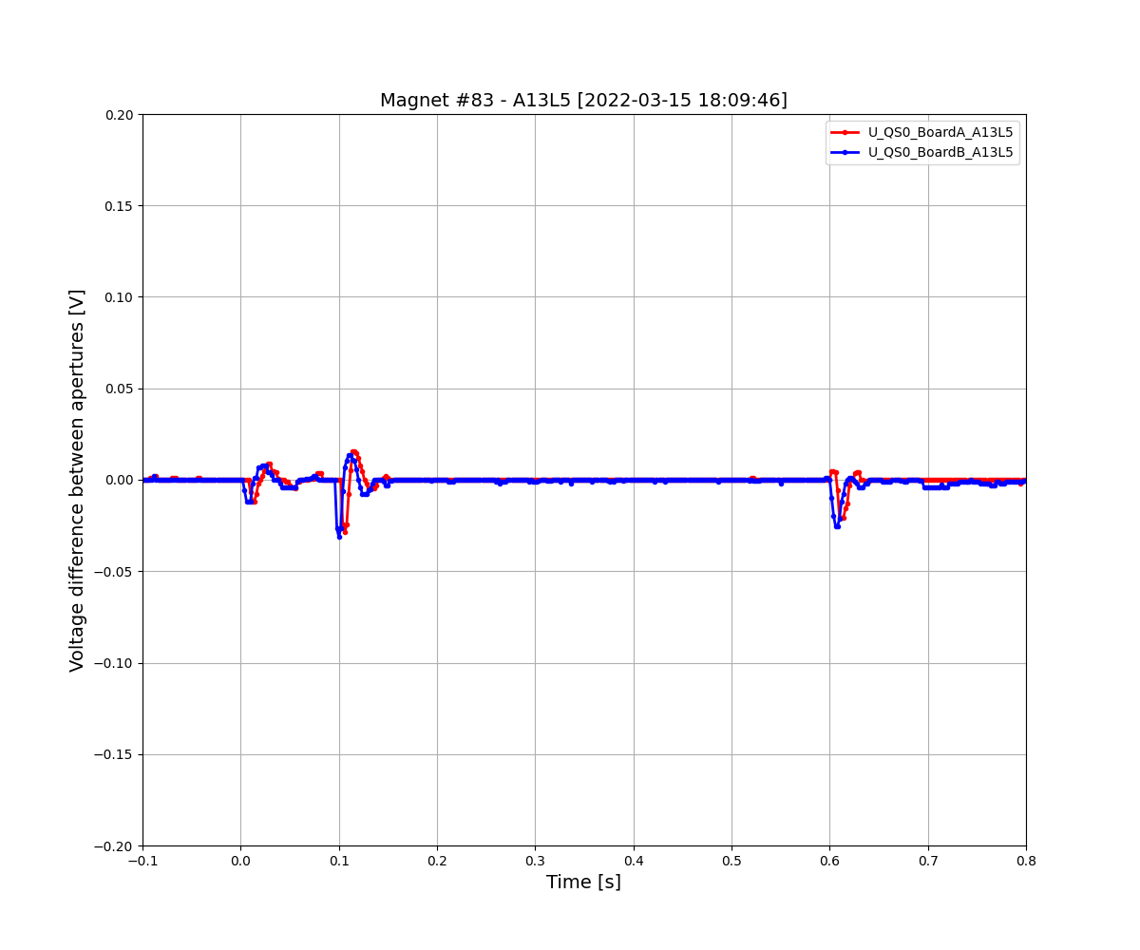
Board A/B changes in time – Now sudden offset disappears #1
2018
2022

Slide 53
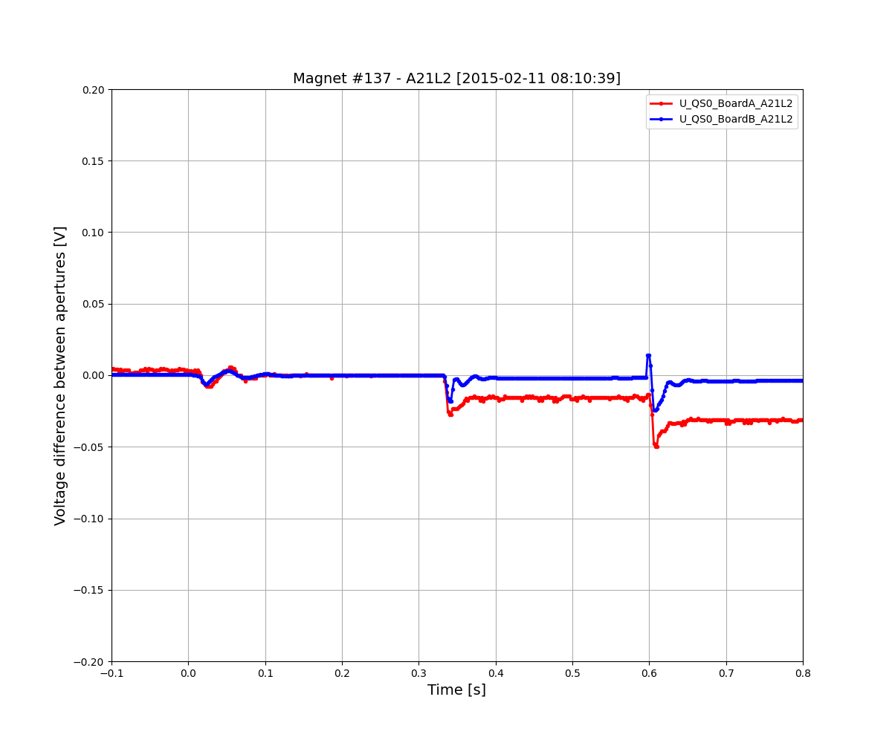
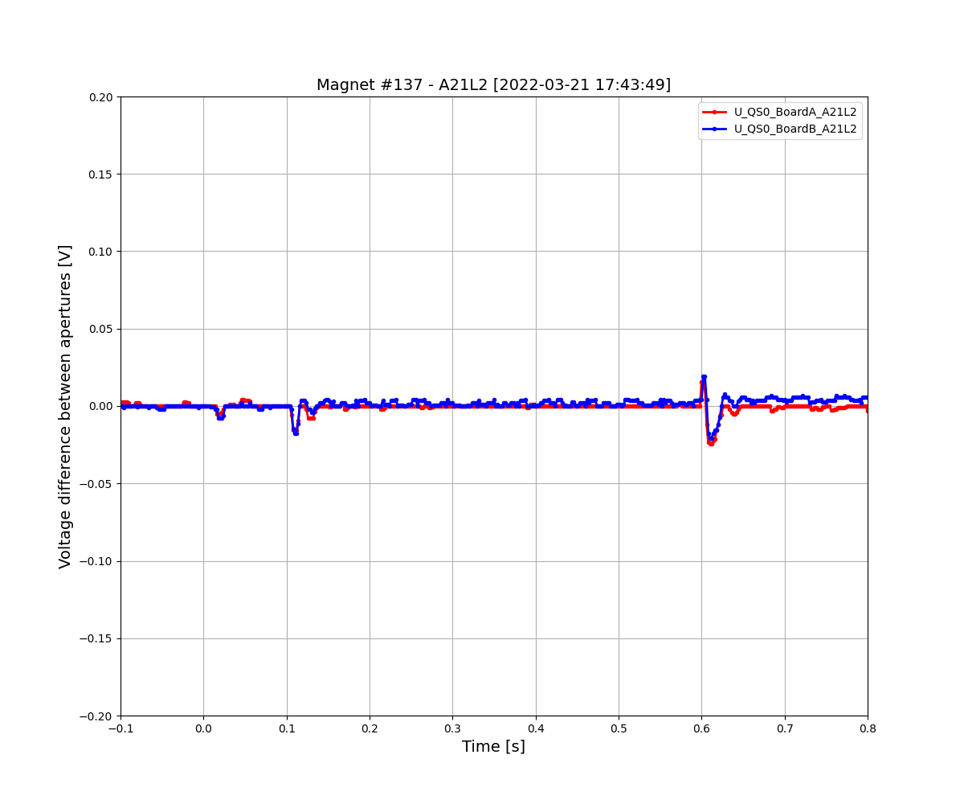
Board A/B changes in time – Now sudden offset disappears #2
2015
2022

Slide 54
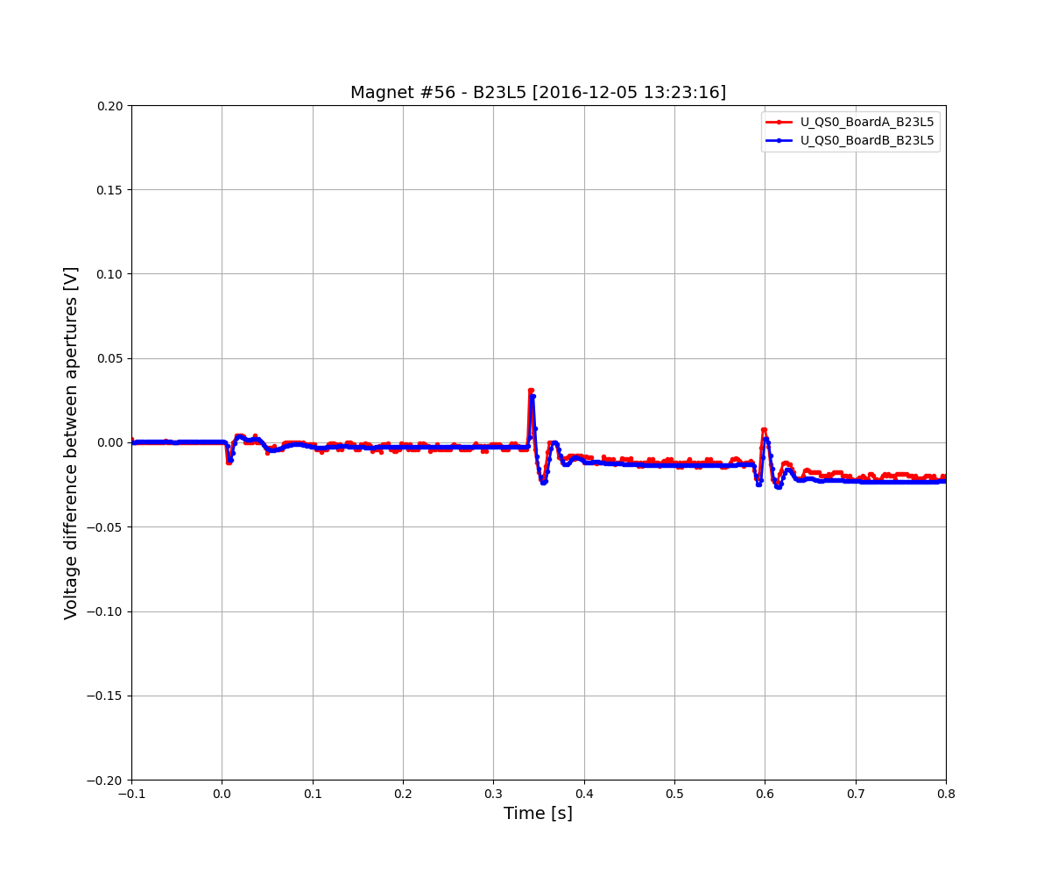
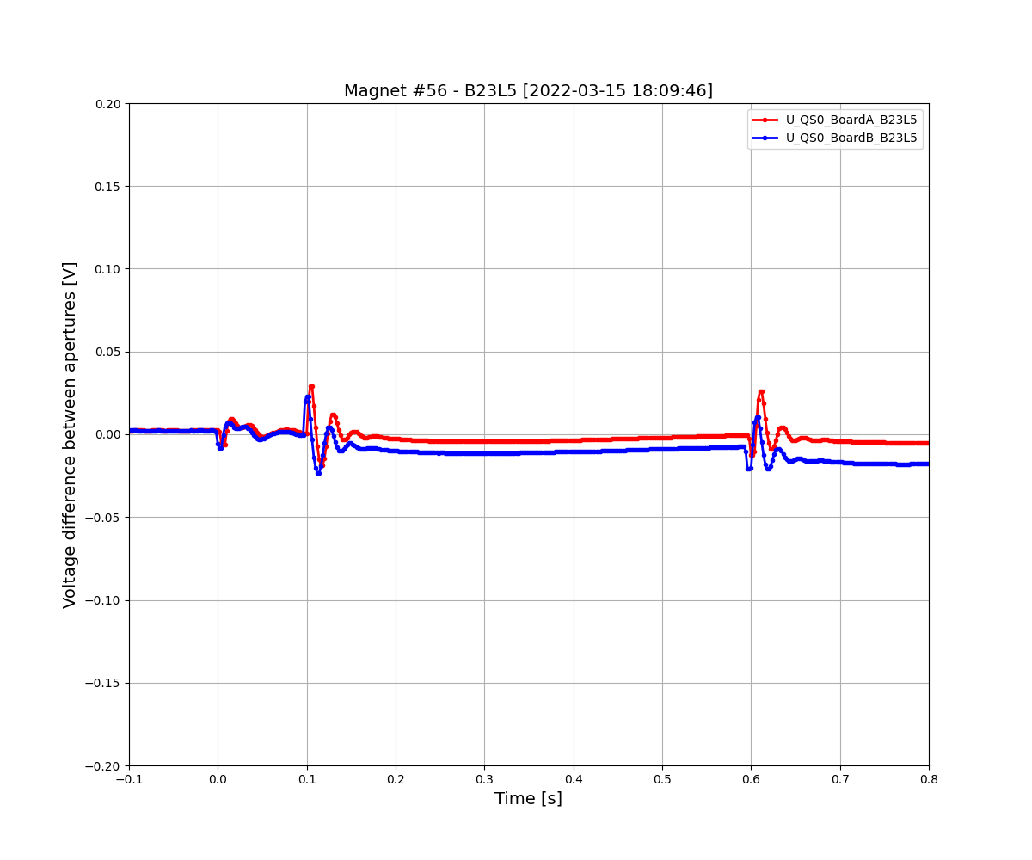
Board A/B changes in time – Now sudden offset appears in 1 board
2016
2022

Slide 55
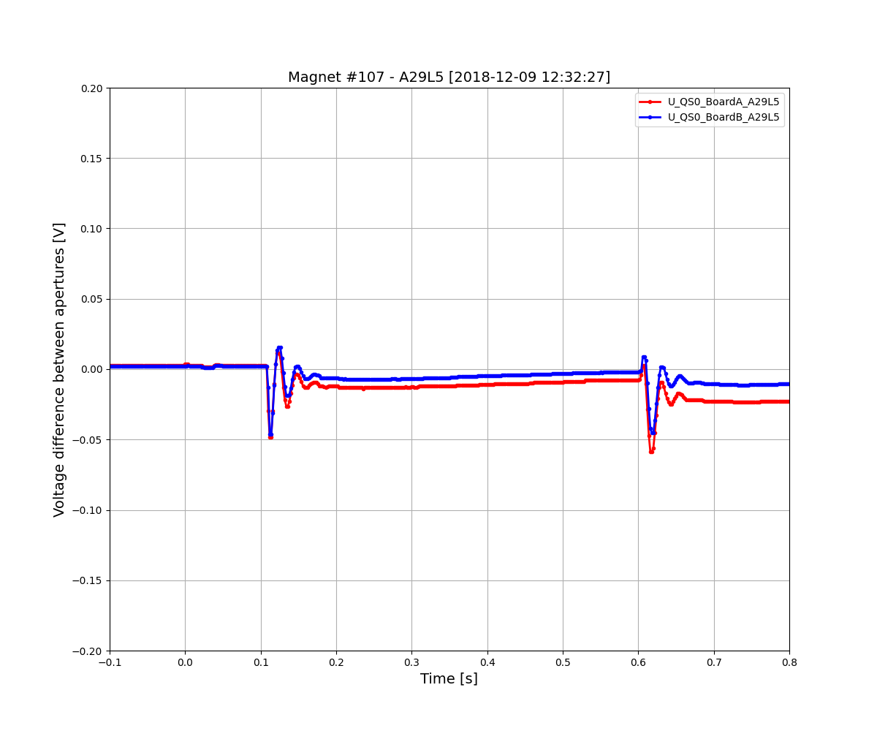
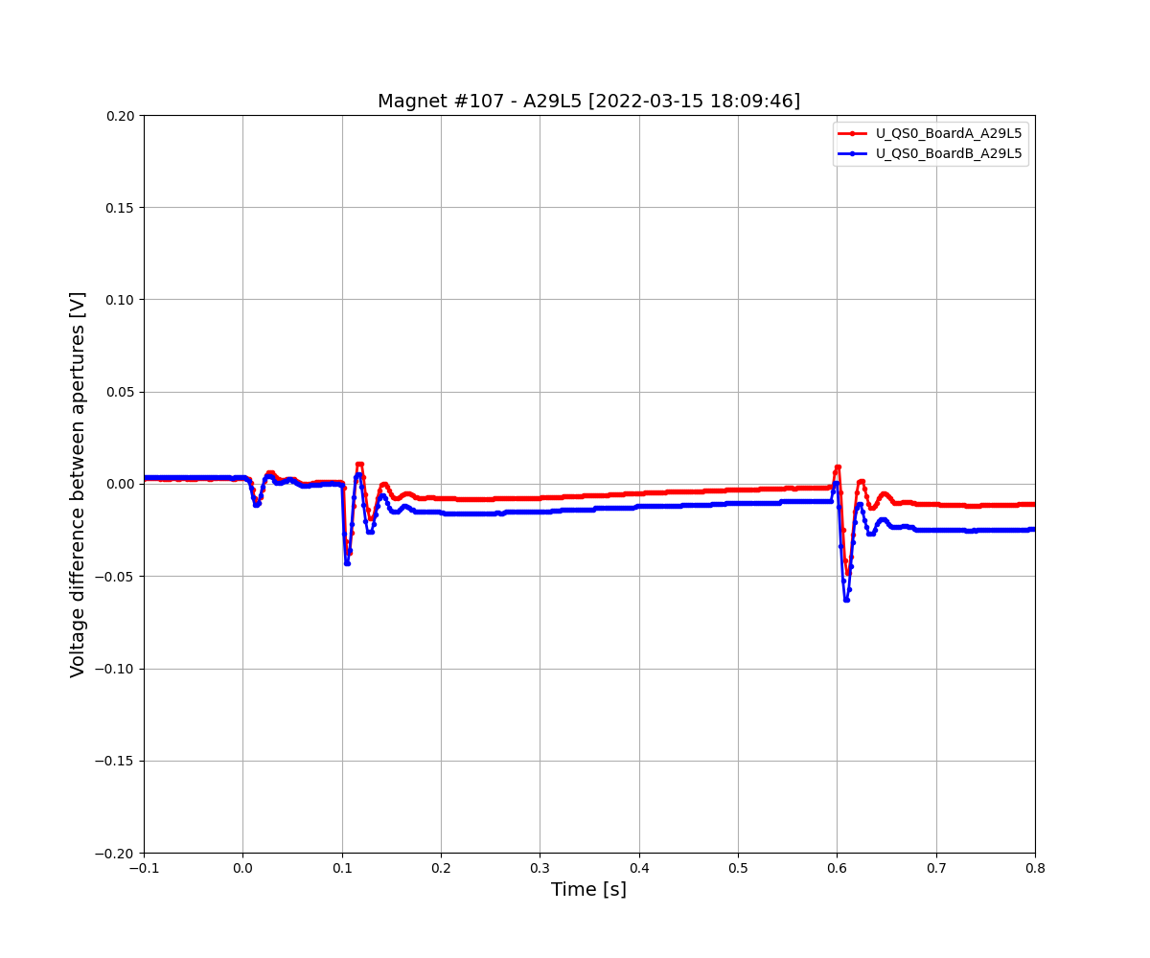
Board A/B changes in time – Now swapped but ~identical signals
2018
2022

Slide 56
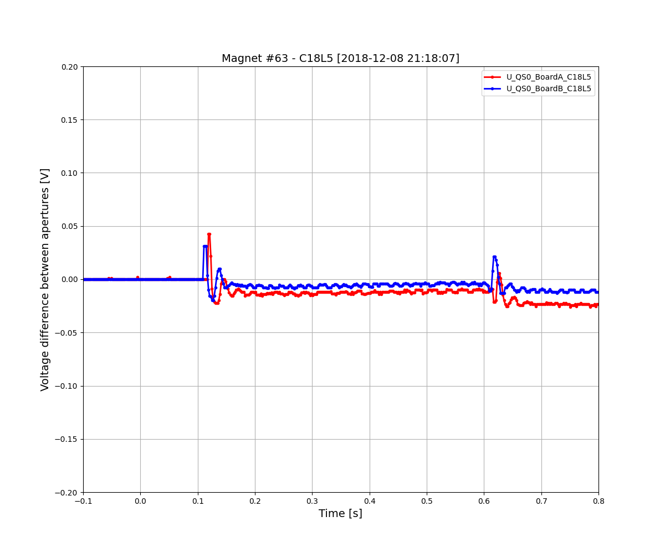
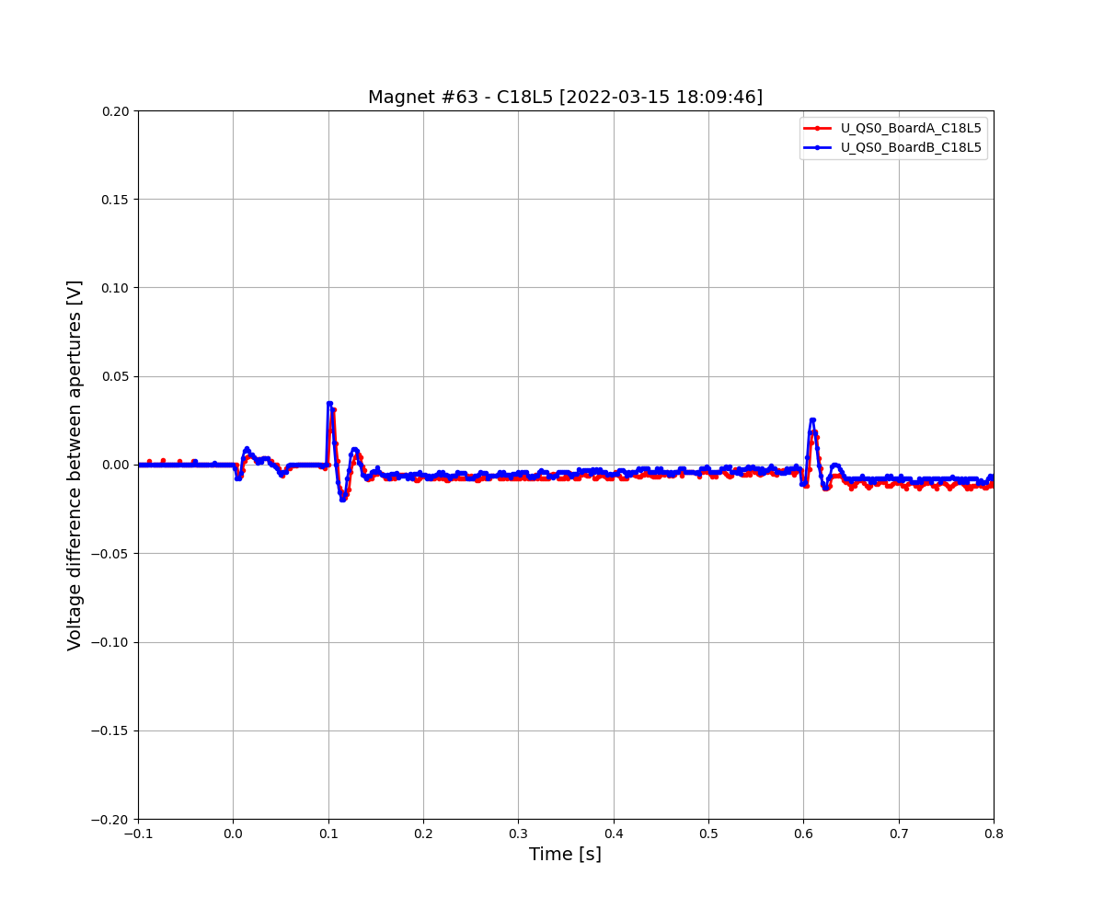
Board A/B changes in time – Now it seems “sudden offset”
2018
2022

Slide 57
Observations on 2014-15, 2015-16, 2018, 2021-2022 Snapshot tests
The “unbalanced” magnets did not change their behavior over time
The “slow unbalanced” magnets did not change their behavior over time
The “sudden offset” and “different board A/B” magnets did change their behavior over the years
Preliminary conclusions
“Unbalanced” and “slow unbalanced” behaviors are due to physical effects in the magnet/coils/conductor
The “unbalanced” behavior is due to eddy currents in the beam screen
The “sudden offset” and “different board A/B” behaviors seems to be due to QPS boards and/or wiring, and are potentially the same behavior

Slide 58
C. SIMULATE
Eddy currents in beam screen
Inter-filament coupling currents
Inter-strand coupling currents
Persistent currents
Eddy currents in metallic wedges
Eddy currents in iron yoke
Stray parasitic capacitances
Eddy currents in beam screen
Inter-filament coupling currents
Inter-strand coupling currents
Persistent currents
Eddy currents in metallic wedges
Eddy currents in iron yoke
Stray parasitic capacitances
Eddy currents in beam screen
Inter-filament coupling currents
Inter-strand coupling currents
Persistent currents
Eddy currents in metallic wedges
Eddy currents in iron yoke
Stray parasitic capacitances
Eddy currents in beam screen
Inter-filament coupling currents
Inter-strand coupling currents
Persistent currents
Eddy currents in metallic wedges
Eddy currents in iron yoke
Stray parasitic capacitances
Magnet “DC” inductance
Stray parasitic capacitances
Eddy currents in beam screen
Inter-filament coupling currents
Inter-strand coupling currents
Persistent currents
Eddy currents in metallic wedges
Eddy currents in iron yoke
Eddy currents in collars
…others?

Slide 59
Equivalent MB magnet models developed in the MPE-PE section
2011 equivalent model | 2022 equivalent model
Good accuracy | Good accuracy
Empirical (not physics-driven) | Physics-driven
Predictive only for FPA | Predictive for various events
 | Able to predict new magnet’s behavior?
 | Possible to add a short circuit to the model
Not easily scaled | Scaled with current
Not easily expandable | Expandable with other effects
 | Expandable to frequency behaviour
Practical | Difficult to develop ;-)

Slide 60
Simulating eddy currents in the beam screen
Beam screen measured surface resistance
Beam screen Cu layer thickness and RRR
Physics-based magnet model
Compare to FTM frequency domain measurements
Compare to FPA time domain measurements
Beam screen figure from the LHC Design Report

Slide 61

Simulating eddy currents in the beam screen
Beam screen measured surface resistance
Beam screen Cu layer thickness and RRR
Physics-based magnet model
Compare to FTM frequency domain measurements
Compare to FPA time domain measurements
Beam screen figure from the LHC Design Report

Slide 62
Simulating eddy currents in the beam screen
Beam screen measured surface resistance
Beam screen Cu layer thickness and RRR
Physics-based magnet model
Compare to FTM frequency domain measurements
Compare to FPA time domain measurements
Beam screen figure from the LHC Design Report

Slide 63

Simulating eddy currents in the beam screen
Beam screen measured surface resistance
Beam screen Cu layer thickness and RRR
Physics-based magnet model
Compare to FTM frequency domain measurements
Compare to FPA time domain measurements
Changed magnets
A20L3
A23R2
B14R2
B16R2
B17R2
B25R2
C15L3
C31R2
Beam screen figure from the LHC Design Report

Slide 64
Simulating eddy currents in the beam screen
Beam screen measured surface resistance
Beam screen Cu layer thickness and RRR
Physics-based magnet model
Compare to FTM frequency domain measurements
Compare to FPA time domain measurements
Beam screen figure from the LHC Design Report

Slide 65
D. Metadata: all data in one spreadsheet, and look for correlations
Magnet information
Electrical location
Physical location
Chronological order
Exchanged magnets
Magnet manufacturers
Cable manufacturers
Strand manufacturers
Beam screen resistances
Collars information
Iron yoke information
QPS card replacement
Frequency-domain measurements
Low frequency impedance
Medium frequency impedance
High frequency impedance
Aperture impedance difference
Effect of magnet T
Effect of beam screen T
Effect of magnetic pre-cycle
How good/bad simulations are
Time-domain measurements
FPA - “Normal” magnets
FPA - “Unbalanced” magnets
FPA - “Slow unbalanced” magnets
FPA - “Sudden offset” magnets
FPA - “Different board A/B” magnets
FPA - Change of behavior in time
Occurrence of secondary quenches
U_DIODE behavior
Occurrence of training
Behavior during SM18 training quenches
Special test with different beam screen T
How good/bad simulations are
Black=in the spreadsheet. Blue=Studied, not in the spreadsheet. Red=Not yet studied systematically

Slide 66




Extra: Frequency analysis of RB events by Christoph Obermair
Goal: Use data to better understand frequencies in RB circuit to:
Compare data to PSPICE simulations from MPE-PE STEAM-Team
Detect circuit anomalies
Study occurrence and the spread of frequencies $→$ Frequency Position Maps
1st EE
Plateau
fft
2nd EE
Plateau
2nd EE switch off
1st EE switch off
PC Switch off
Event:
RB_RB.A78_1617170255140000000 2021-03-31 07:57:35.120000 Primary Quench at el. Position 141

Slide 67
Conclusion
CLASSIFY – Time domain analysis
“Unbalanced” and “slow unbalanced” behaviors are due to physical effects in the magnet/coils/conductor
The “unbalanced” behavior is due to eddy currents in the beam screen
[Preliminary speculation] The “sudden offset” and “different board A/B” behaviors seems to be due to QPS boards and/or wiring, and are potentially the same behavior
MONITOR
The “unbalanced” and “slow unbalanced” magnets did not change their behavior over time
The “sudden offset” and “different board A/B” magnets changed their behavior over the years
SIMULATE
Physics-based model in time and frequency domain explains the behavior of ~90% magnets (“unbalanced”)
Behavior of ~10% magnets (“slow unbalanced”) cannot be explained by beam screen eddy currents
METADATA
All data in one spreadsheet, and look for correlations

Slide 68
Proposed actions
CLASSIFY
Correlate results of FPA (time domain) and FTM (frequency domain) analyses → Understand “slow unbalanced”
Study history of QPS card replacement → Understand “sudden offset” and “different board A/B” magnets
Analyze U_DIODE signal systematically
Analyze special Machine Development (MD) tests where beam screen of selected magnets had different T
MONITOR
Periodically perform FPA Snapshots: [2 kA, 10 A/s] and [11 kA, 10 A/s]. And record U_DIODE at 2 kA as well?
Once perform a FPA Snapshot [11 kA, 10 A/s] test with different magnetic per-cycle (study persistent currents)
Automate better FPA analysis. And eventually integrate it in the analysis notebooks?
Is it possible to always record all 154 U_QS0 signals whenever a FPA is triggered? [permanent snapshots]
SIMULATE
Implement new physical behaviors in the model → Understand “slow unbalanced” behavior
Study the effect of short circuits in the time and frequency domains
METADATA
Update the spreadsheet with more information and make it widely available

Slide 69
Annex

Slide 70


LHC main dipole circuit (RB)
Power converter
Filter
77 Magnets
EE Switch1
Crowbar
EE Switch2
77 Magnets

Slide 71



Min/max U_DIODE during FPA at 2 kA, 10 A/s in RB12
During PC switching off
During EE1 opening
During EE2 opening

Slide 72


Comparison of meas and sim max(U_QS0)-min(U_QS0) @11 kA, 10 A/s
During PC switching off
During EE2 opening

Slide 73


abs(max(U_QS0)) for PC switching-off and EE2 opening
During PC switching off
During EE2 opening

Slide 74


abs(max(U_QS0)) for PC switching-off and EE2 opening – distribution
During PC switching off
During EE2 opening

Slide 75
















abs(max(U_QS0)) for PC switching-off and EE2 – distribution by sector
During PC switching off
During EE2 opening

Slide 76
Practical magnet classification and proposed actions
0. → ~zero U_QS0
Relax
~650
1. → Explained by beam screen. Large U_QS0
Raise threshold or change magnets
0
2. → Explained by beam screen. Small U_QS0
Write a paper about it. Monitor them
~460
3. → Unexplained by beam screen. Board A ≠ Board B
Study board change history. Check FTM.
~60
4. → Unexplained by beam screen. Board A ≡ Board B. Small U_QS0
Check FTM. Understand the cause(s). Monitor them
~130
5. → Unexplained by beam screen. Board A ≡ Board B. Large U_QS0
Check FTM. Analyze more thoroughly, and monitor them
~10

Slide 77


Beam screen Cu thickness and RRR deduced from measurements -1
Thickness of Cu layer
RRR

Slide 78

Beam screen Cu thickness and RRR deduced from measurements -2
plotted by circuit
plotted by beam screen batch

Slide 79
Simulating eddy currents in the beam screen
Beam screen measured surface resistance
Beam screen Cu layer thickness and RRR
Physics-based magnet model
Compare to FTM frequency domain measurements
Compare to FPA time domain measurements
Beam screen figure from the LHC Design Report

Slide 80












Extra: Frequency analysis by Christoph Obermair – 2
Systematic approach to analyze frequencies:
Show occurrence and the spread of frequencies
Decompose frequencies based on origin
Display expected frequencies depending on a quench
Event:
RB_RB.A78_1617170255140000000 2021-03-31 07:57:35.120000 Primary Quench at el. Position 141
$$≈$$
$$+$$
$$+$$
$$+$$
$$+$$
Common Oscillation
Physical Propagation
Electrical Propagation
Power Converter
Energy Extraction

